Slide 1



Off-Campus Research
Dixie Shafer
Augsburg University
Office of Undergraduate Research & Graduate Opportunity (URGO)
Notes:
Dixie

Slide 2
What is Off-Campus Research?
Competitive programs at research universities for undergraduates
  The research university environment
8-12 weeks of full-time research under a research mentor
  Often a cohort model that can include professional development seminars, guest speakers, courses, cultural outings, GRE prep
  Difference programs: goals, targeted students, requirements
Paid (+ housing, travel, and food allowance)
Notes:
Dixie

Slide 3
Why do Research Off-Campus?
Why do research?
Why off-campus?
Explore topics in-depth and discover what interests you in your field
Enhance your writing, speaking, and critical-thinking abilities
Become a more competitive applicant
Explore new sub-fields and specialty areas
See what research at an R1 looks like
Get to know a department’s culture: faculty, grad students, work culture
Possibilities of publishing
Extend your network
External letter of rec
Explore a new city!
Notes:
Why do research? (additional reasons)
Develop technical and marketable skills
Build a professional relationship and reputation with a faculty mentor
Network with peers and professionals in your field

Slide 4
Eligibility
Course completion requirements
Academic standing (first-year, sophomore, etc.)
Citizenship
GPA
Major
Underrepresented as defined by the program
Read preferences:
  Community college students
  Underrepresented populations
  Previous research experience
  Interested in PhD or health sciences
Notes:
Dixie

Slide 5
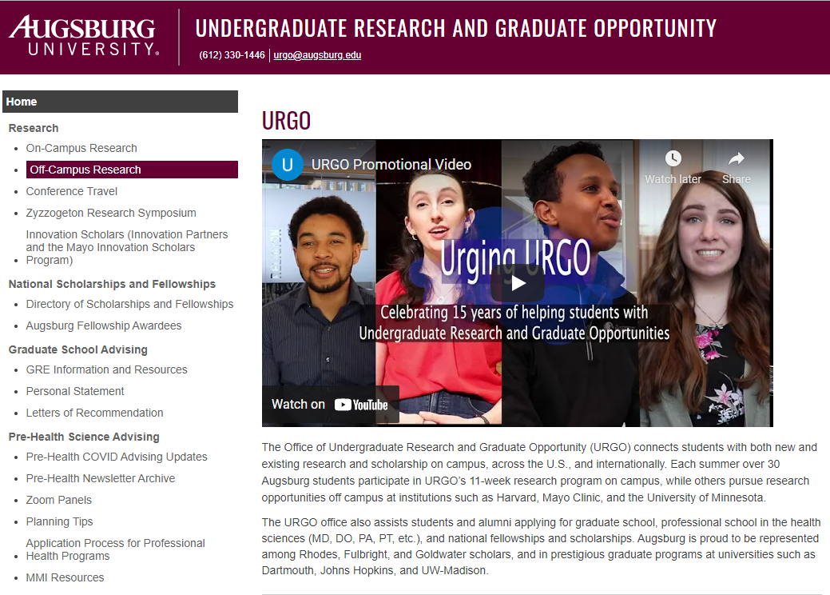
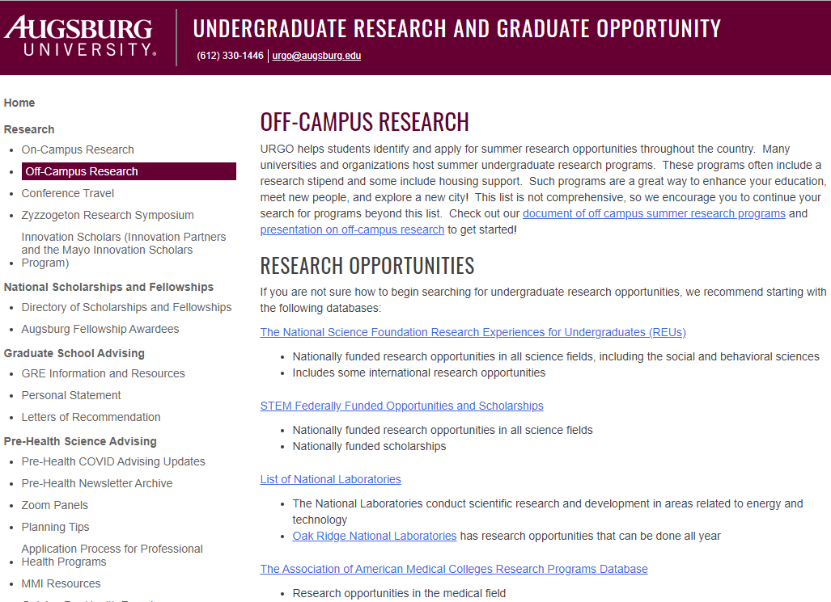
How to Find Opportunities
Faculty
URGO’s website
  REUs
Other colleges’ databases
Your field’s professional organizations
Apply to 3-6 programs
Notes:
It is a bit of a research project to find the research opportunities
Google: National labs, medical centers, graduate schools you want to go to, etc.
NOTE: Some programs pop up later from funding
Don’t focus only on “cool” locations
Past students - https://caice.ucsd.edu/get-involved/opportunities/
REU search
Biology – Colorado State
Chemistry – Kent State
Computer Science – Arizona State
2. STEM Federally funded – NIH internships and military
3. AAMC – Baylor Medical
Reading eligibility on a page and find deadlines -

Slide 6
Highlighted Programs
Community College Fit
Minnesota Programs
Parkland
  Biology
Montana State
  Computer Engineering
Kansas State
  Chemistry
NIH CC SEP
  Biomedical sciences
UMN programs
  Computer Engineering REU
  Lando - chemistry
  SUMMIT
  Lillehei Heart Institute
  LSSURP
  McNair scholars
Mayo Clinic programs
  Biomedical Ethics
  SURF
DOE Scholars Program
Notes:
http://www.ece.montana.edu/research/ece_reu/index.html - Computer engineering
Virtually all are seeking community college applicants and those from small teaching institutions

Slide 7

Things to Consider…
Research being conducted
Programming
Funding
Competitiveness
Notes:
Research that is being done there (may be list of projects from previous years, faculty, can call to ask who is taking students)
Programming provided (some very structured, some less so; GRE prep, Resume building, social events, poster sessions, travel opps)
Funding: Stipend, housing, travel
Competitiveness – some may indicate number of applicants previous year, can call program managers
DO NOT just consider the name of the school – it is about the program.

Slide 8
Application Components
CV/Resume
  Get it reviewed!!!
Online application with biographical information
2 recommendation letters from faculty in your major or related fields
Transcripts
  Low grades might need explanation
Personal statement or short answer questions
  Get feedback on multiple drafts
Deadlines
Most due January-February
Notes:
CV - can be more than 1 page
Transcripts - below 3.0 you need to show why this doesn't reflect your true potential; need to illustrate you will be successful
Letters of rec – pick someone who can speak about your potential as a researcher in your field
Deadlines – usually due Jan - March, but some pop up in April; may have a short turnaround time
Sometimes may have you rank your projects/faculty
AUGSBURG STUDENTS: off-campus workshop 1st weekend we’re back to school in January.

Slide 9
Sample Prompt - Single Essay
Please explain why you would like to participate in the program. Your answer should be approximately 400-1000 words. You may want to incorporate your reasons for seeking this type of experience, the appropriateness of you academic preparation for full-time lab research, any previous research, and/or your particular academic and career interests.

Slide 10
Sample - Multiple Prompts
200 Word Prompts
Why would you like to do research with this program this summer?
What attracted you to your top choice project?
What are your career goals?
What other experiences do you have that might be relevant for research?
What skills do you hope to acquire during the summer program?

Slide 11
Breakout Room Activity
Think of 5 skills researchers need
Discuss how you would demonstrate 2 of those skills
Notes:
Breakout Room
Check with Dupont and Wentzel

Slide 12
Tips - Other Relevant Items
Research experience
Class projects
Leadership experience
Work experience
Skills:
  Writing, problem-solving, critical thinking, time management, learning from mistakes, working in a team
Attributes:
  Detail-oriented, self-motivated, persistent, adaptable, hard working, curious, reliable
Notes:
If you don’t have previous research experience, discuss outreach or classroom activities you participated in which show your interests in a field, and explain how these are related to the type of research you may participate in at the REU.
Go through tips – pick and choose

Slide 13
Fitting Funder’s Mission
Liberal Arts and Community Colleges
To prepare myself for graduate study, I would like an additional research experience. I come from a small college where undergraduate research opportunities in biology are limited. Conducting research at an institution like Boston University provides access to greater technology and learning through seminars as well as dialogue with established researchers. Having access to a larger lab and more advanced equipment would greatly benefit my research skills. Participating in SURF would aid me in becoming the well-rounded and skilled scientist I hope to become, one day supervising a lab at a university or in industry.
Notes:
REUs are designed to offer cutting-edge lab experiences for students at liberal arts and community colleges, where students have fewer opportunities to be exposed to research. (liberal arts – used to be more common for faculty to be just teaching).

Slide 14
Fitting Funder’s Mission
Underserved Students
I have realized my passion for research during my first year at community college. But, as a low-income, first-generation college student, there were few role models in my life who could guide me in finding the opportunities to gain skills and experiences in scientific research. My department at Minneapolis College is very supportive but does not have funding to provide research opportunities outside of coursework. Because I hope to be that role model for other students who come from similar circumstances, the opportunity at the University of Nebraska Summer Undergraduate Research Program will fill an important role in helping me develop as a researcher.
Notes:
FICTIONAL

Slide 15
Coursework
In my computer science classes I am learning to determine what an algorithm does, as well as how to create algorithms to solve problems, such as sorting lists of data. I am building on my previous experience, expanding my understanding and comprehension of what it means to be a computer scientist. For example my Introduction to Java class comes fairly easy to me not because I have programmed in Java before, but instead because I have used object oriented languages such as Swift and ObjectiveC for IOS devices. Math courses in Calculus I and II, along with Introduction to Statistics have really helped me understand the multitude of different relationships between complex theorems, such as the fundamental theorems of calculus. With a strong background in math I can more easily create simple solutions to complex problems.
Notes:
IF NO PRIOR RESEARCH – this is KEY

Slide 16
Prior Research or Class Project
I completed 400-hour research project under the supervision of Dr. Matthew Beckman. The focus of the lab is working with a single-eyed crustacean, Daphnia magna, to illuminate the genetic origin of this anomaly. I had the task of conducting a side project looking at a closely related crustacean, focusing on its eye development along with hedgehog gene expression. I collaborated often with my lab mates and established a close rapport with my mentor. From this, I gained confidence in my decision making and learned new methods pertaining to molecular biology such as using RT -qPCR comparative Ct method to measure gene expression. I successfully completed my work having developed a protocol for culturing the animals, designing and validating a primer and probe set, as well as giving a written and oral report on my findings.
Notes:
Maybe remove
REUs are about RESEARCH.
Need to show interest in research. In coursework? History of your own research?
Show record of research or skills – be sure to talk about what YOU did as part of the project

Slide 17
Reflection on Past Experiences
I learned that research is an exercise in delayed gratification, much different than the immediate results I experienced while completing lab work for my courses. For example, when validating my primer and probe set for qPCR, it took far longer than I originally thought it would. Another challenge was devising a method to culture animals that the lab previously had no success with. Despite this, I forged on and was able to begin collecting preliminary data. While some days I would be frustrated with the lack of results, even the slightest promise of newfound knowledge kept me returning each day.

Slide 18
Why this Program?
NIST laboratories are the perfect fit for my interest in cutting-edge research in spectrometry or applied mathematics and simulation. A position at NIST would aid me in making decisions about a graduate research focus and provide me with necessary experience working in a large lab. It would help better identify the type of research environment that is the best match for my interests and abilities and provide direction for my scientific career…. A research position at NIST will help expand my research skills, my knowledge, and my experience, all of which I am determined to improve. I would like to improve my communication skills while at NIST through the communication I will have my mentor and other scientists. I want to advance a NIST project this summer with my participation and I want get the most I can out of my time at NIST.
Notes:
GOOD: could be faculty, projects, programming, considering for grad school
BAD: beach in Florida, prestige of Yale, close to home, earns money, required for med school, adds to your resume, generic reasons (“good school, excellent researchers”)

Slide 19
What Research Interests You?
Comparative genomics along with genetics are also fields that greatly interest me. This is why I find the project on Myxozoan Parasites of Amazonian Fishes so compelling. It is clear that these microscopic organisms are a widespread issue for farmed fishes as well as wild populations. Just reading a few articles left me eager to delve into the genetics of their parasitism. I have experience working with small amounts of genetic material to amplify and this is a process I would like to continue and develop. The prospect of working on a largely genetics-based project excites me, in addition to learning how to apply bioinformatics to findings. Because I am considering graduate study in genomics, it is important that I learn how to analyze complex data. I strive to become more interdisciplinary, and this project would give me a new perspective on problem-solving.
Notes:
Read what the faculty are currently working on, and even better if you read their abstracts.
Good – show you know what work they’ve done
Better – Explain how you would be prepared for work in their lab

Slide 20
Future Plans and Goals
Participation in Cornell’s Microbial Friends and Foes program will contribute another important step in achieving my academic and professional goals. Whether I am looking into disease resistance with Dr. Gary Bergstrom or Dr. Rebecca Nelson or looking into nutrient acquisition and plant-fungi symbiosis with Dr. Maria Harrison, I know that I will learn a great deal about plant pathology no matter who I work with. Following my time at Augsburg I hope to attend graduate school so I can participate in research either in an industry position or in an academic setting. With my graduate degree, I hope to further the knowledge of plant genetics and plant-microbe interactions, as these fields have such great potential in supplying food in the most efficient way for an ever growing global population.
Notes:
HOW THIS EXPERIENCE WILL HELP YOU REACH YOUR GOALS
Make sure to make it clear you will go on to finish at least a 4-year degree.
If you feel like you would consider grad school, Want to talk about graduate school as a possibility
NOT A CONTRACT. You don’t need to be sure of what you are going to do – can offer possibilities- not obligated to tell them everything you ever have thought of doing , though.

Slide 21
What Happens Next?
Acceptance notifications vary by program
  Some notify quickly, some take months
Short time to make decision
Most have waitlists
What to do when accepted to more than one opportunity?
Notes:
Could skip
More than one opportunity? Talk to faculty, family, past participants, coordinator ----may depend on if you know who you will be placed with ---- consider alignment with your ultimate goal

Slide 22
Contact for Augsburg Students
urgo@augsburg.edu

Slide 23
Thank You and Questions

