Slide 1
Preparing for the Fall 2015
Career & Internship Fair
Notes:
-Introduce yourself and your role
-If there are a small amount of students, you can have them introduce themselves, their year in school and major too if you would like

Slide 2

Learning Objectives:
Be able to locate Career and Internship Fair information and preparation resources on the Strommen Center Website
Be able to identify at least one cultural norm around professionalism within the U.S.
Feel more confident with their ability to successfully interact with employers at the Career and Internship Fair
As a result of this Prep Session, students will….

Slide 3

Agenda for today:
Career and Internship Fair Overview
What to expect
Tips →
    Before the Fair
    During the Fair
    After the Fair
Logistics
Upcoming Events
Questions?

Slide 4

Career and Internship Fair Overview
Thursday, September 24th
3:00 to 6:00 p.m.
Augsburg College, Oren Gateway Center Lobby
More than 20 employers!
Open to all Augsburg students (including Graduate students).

Slide 5

The key to a successful Fair?
Preparation.
Insider Tips…
… the Fair
Before
During
After
Notes:
The key to a successful Job Fair experience is PREPARATION! So, now we will talk about some strategies for preparing for before, during, and after the fair.

Slide 6
Before the Fair
The basics:
Register – online, FREE.
Attend a Prep Session – CHECK!
Prepare your resume.
We strongly advise you to have your resume reviewed during Career Quick Stop hours before the fair.

Slide 7
Before the Fair
Stand out by:
Clarifying your goals.
Making a list of your top employers.
Doing your research.
Preparing your elevator pitch.
Preparing questions to ask employers.
Planning your attire.
Thinking about what you will bring.
Notes:
Talk about clarifying students’ goals for the fair - what are some examples:
What is your main goal for the Fair?
Searching for a job or internship or just testing the waters/exploring?
How many employers want to connect with?
What kinds of opportunities are you seeking?
Trying to explore different industries?
What would a successful Fair look like for you?
How does this Job Fair fit into the mix of all the various job/internship search activities you are engaged in?
Realize this is just one avenue for finding opportunities – keep in mind 80% of jobs are never posted.

Slide 8
Researching employers
How would you do this?
Notes:
Solicit ideas from students first:
How would you research employers?
What would you want to know?
When would you do this research?

Slide 9
Researching employers:
Access the Career and Internship Fair webpage to see who is coming.
See what open positions they have.
Go to the company website to explore.
Visit the company career page online.
Check out Linked In.
Google them.
Then Google and filter to see their News stories too.
Use our Employer Research Tip Sheet to make notes and stay organized.

Slide 10
Preparing your Elevator Pitch
Making a good impression!

Slide 11
Elevator Pitch
10-15 second introduction explaining…
  Who you are (Major, School, Career Interests, etc.)
  What you have to offer (Unique and relevant skill or strength)
  What you are looking for (A skill you hope to develop or something that interests you about the employer)
Example:
  “Hi, I’m Auggie Eagle, and I am the mascot at Augsburg College. I have experience motivating and engaging people at athletic events and am now looking for an opportunity to build my communication skills in non-athletic situations through an internship with Alumni Relations”
Notes:
HANDOUT
-If time, have the participants practice their own elevator pitch

Slide 12
Prepare your Questions
What information do you want to gather from employers?
Notes:
Person vs. pamphlet questions:
Avoid asking questions that you can easily answer from reading a pamphlet, brochure, or website - instead, ask questions that can only be answered by a person (examples on next slides)

Slide 13
Questions for Employers:
DO
DON’T
I read online that XX… can you tell me a bit more about that?
What does your company do?

Slide 14
Questions for Employers:
DO
DON’T
What qualities do you seek in ideal candidates for this position?
How much does this job pay?
What jobs do you have?
Notes:
Avoid asking about pay until you are offered a position ☺

Slide 15
Questions for Employers:
DO
DON’T
I am looking for a position that will enable me to grow my skills in XX and XX. What professional development opportunities are available here?
Miss out on asking in-depth questions that demonstrate skills and interest in the organization or position.
Stammer with ill-prepared questions.
Share your weaknesses.

Slide 16

In summary…
Notes:
Talking points:
Be prepared.
Use questions to sell yourself well.
Engage in natural conversation.
Listen sincerely and enjoy the experience.
Image: http://www.wileyvalentine.com/blog/2012/06/07/be-your-best-self/

Slide 17
Plan your attire.

Slide 18
Attire
Clean, pressed, and well-fitting.
Professional – in doubt? Go simple & conservative.
Sensible – lots of walking involved.
Consider culture and personal style in your choices.
Your attire should help the employer focus on you – avoid anything that could distract from your message.
Notes:
Make sure your shoes are comfortable – limit to 2 inch heels

Slide 19

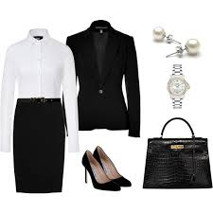
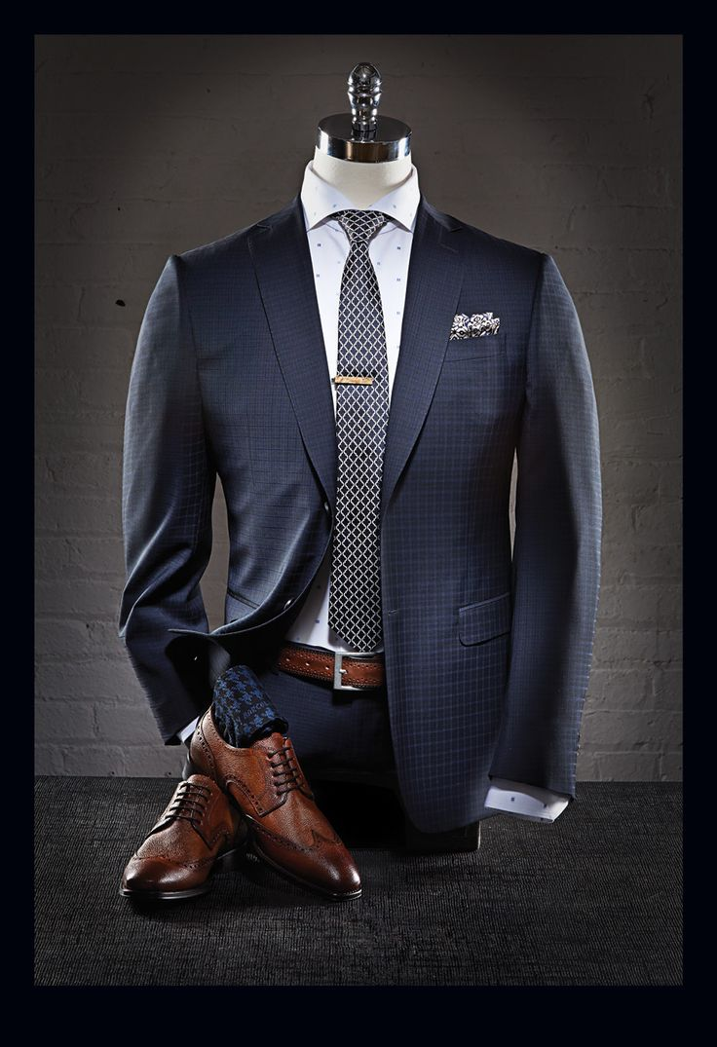


Examples
Notes:
TIPS:
-Practice good hygiene: brush your teeth, wear deodorant, keep facial hair well groomed, limit scents
-Simple hair, makeup, and accessories
-Stick to low-key color schemes: navy suit, white or light blue shirts, mellow ties.
-Suit and tie or dress shirt with dress slacks or skirt.
-Blouse, shirt, or shell that gives you good coverage.
-Socks match pants & shoes match belt.

Slide 20

Avoid…
Dirty, wrinkled, stained clothes.
Too much skin.
Awkward or uncomfortable fit (you want to avoid pulling or tugging at clothes, fidgeting, etc).
Backpacks and bulky bags.
Inappropriate clothes that makes them question your competence.
Perfume/loud jewelry, excessive makeup.
Shirts/ties that are too bold
Skirts that are too short, heals that are too tall.
Notes:
AVOID:
Inappropriate clothes that makes them question your competence/professionalism
Perfume/loud jewelry, excessive makeup
Shirts/ties that are too bold
Skirts that are too short, heals that are too tall.
Dirty, wrinkled, stained clothes.
Too much skin.
Awkward fit, or candidate looks uncomfortable (pulling or tugging at clothes, fidgets, etc).
Backpacks and bulky bags.

Slide 21
Attire Resources
Affordable Dress Clothes:
  JCPenny
  Sears
  TJ Maxx
  Marshalls
  Herbergers
  Target
  Savers
  ARC Value Village
  Goodwill
Visit our Website for more examples:
  http://www.augsburg.edu/strommen/career-preparation/interviewing/
Follow us on Pinterest for more ideas!
  https://www.pinterest.com/auggiecareers/dress-for-success/
Notes:
JCPenny, Sears, TJ Maxx, Marshalls, and Herbergers can be good places to get trousers, blazers, suits, sweaters, and skirts, especially if you only need one or two and don't have a lot of money. JCPenny is a preferred place for me because they always have something on sale in the professional attire categories, or have coupons that can be used for return purchases. Sometimes these places offer tailoring services, but if they don't that can sometimes be done by outside vendors for minimal cost. These places also usually have a pretty good selection of the basics.
Having said that, for some of the more basic stuff (shirts, ties, blouses, sweaters, etc.), Target works well. Target is just limited in selection at times. You can find good affordable accessories at places like Savers, ARC Value Village, and even Goodwill.

Slide 22
Plan what you will bring.

Slide 23
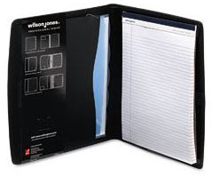
Some ideas:
20 copies of a well-prepared resume
Notebook or Padfolio
Pens

Slide 24
During the Fair
Know where to go, when to arrive.
    Location: Augsburg College, Oren Gateway Center Lobby
Have confidence interacting with employers.
    Begin with employers that are not your favorite.
    Greetings/handshakes.
    Engage in conversation that demonstrates your strengths.
    Be prepared for follow-up – get business cards, leave resumes, etc.
Keep good notes to make follow-up easy.
Notes:
Refer to handout for details.

Slide 25
After the Fair
Plan time to follow-up with employers.
    Send thank you notes
    Email copies of your resume
    Request follow-up meetings
    Apply for positions
    Update LinkedIn and add professional contacts
Keep the momentum going.
    Schedule career coaching appointment
    Reflect on accomplishments and progress towards goals
    Determine next steps – this was just one part of your job search
Notes:
Refer to handout for details.

Slide 26
Additional Career and Internship Fair Resources

Slide 27
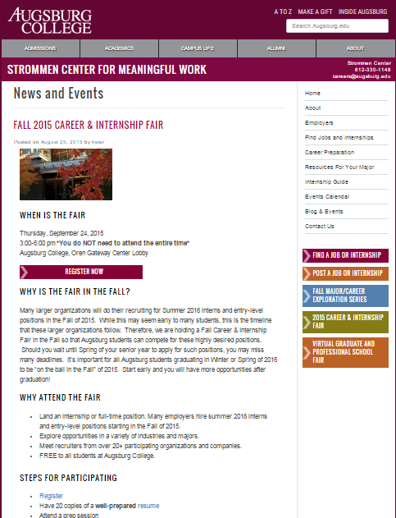
Visit the Strommen Career and Internship Fair Website for more helpful tips:
http://www.augsburg.edu/strommen/2015/08/25/fall-2015-career-internship-fair/

Slide 28

Last Chance Resume Glance
Friday, September 18th
9 a.m. to 2:30 p.m.
Strommen Center for Meaningful Work
--------------------------
Have any last questions or concerns?
Stop by our Career and Internship Fair Drop-in Hours to make sure you have all the finishing touches in place and are ready to go! Career coaches will be on hand to answer questions.

Slide 29


Slide 30

Visit us!
Location: 100 Christensen
Hours: M-Th: 8:30 a.m. to 5:00 p.m. (Fridays closed at 4)
Appointments: 612-330-1148 or stop by the front desk
Questions? Email: Careers@Augsburg.edu or
Visit: http://www.augsburg.edu/strommen/2015/08/25/fall-2015-career-internship-fair/
Career Quick Stop Hours:
Tuesdays and Wednesdays: 2:30-4:00 p.m.
Notes:
Make Sure to Highlight the Strommen Job Fair Website

Slide 31
Questions?
Notes:
Distribute Survey

