Slide 1
From Values to Virtues
Applying Virtue Ethics in Social Work

Slide 2
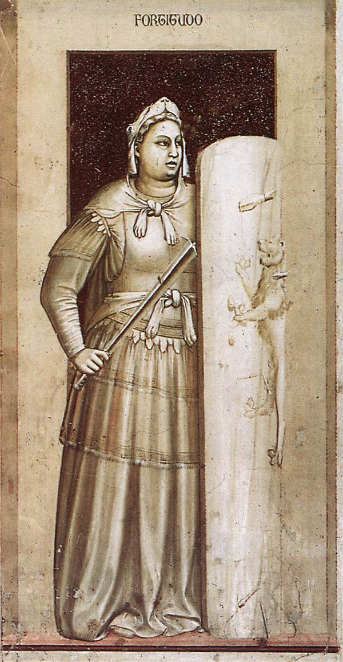

Slide 3
International Discourse in Ethics
IFSW & IASSW Statement of Ethical Principles
Making ethically informed decisions and being prepared to state reasons
E.g.: dilemmas arising from dual role as helper and controller

Slide 4
Three Perspectives
In US, reliance primarily on:
Deontology
Teleology
Internationally:
Virtue Ethics added

Slide 5
Principle/Rule Based Thinking
Deontology: Ethical Duties arise from Universal Principles and Rules
IFSW: Human Rights & Dignity; Social Justice
Core Values >>> Principles:
Autonomy
Beneficence
Non-Maleficence
Fidelity
Social Justice
E.g.: Prohibition against Deception

Slide 6
Utilitarian (Teleological) Thinking
Focus on Results or Consequences of Each Option
Popular among Social Workers
Strengths and Limitations:
Helps with delineating dilemmas
Doesn’t necessarily provide clear direction
We cannot predict outcomes absolutely
Good for majority might be harm for minority
Can lead to contradictory options

Slide 7
Virtue Ethics
Focuses on the actor’s moral qualities (the other two approaches focus primarily on morality of actions)
Virtues = Strengths of Character that Lead to Excellence and Human Flourishing
No single virtue is key, not piecemeal but constellation as needed in particular situation and over a lifetime
Moral motivation grows from person’s character as a whole, guided by the virtue of practical wisdom
Exercising virtuous strengths is wholehearted
Good Fit with Social Work

Slide 8
Virtue Ethics (Cont.)
Gives conscious attention to relationships
Includes emotional intelligence as part of rational decision making
Shares common threads with cultural and religious traditions worldwide
Principles and rules play role, but sometimes they are not sufficient
Looks to exemplars
Limitations

Slide 9
Social Workers’ Thinking
Ana SloboČan:
Etika v socialnem delu (Ethics in Social Work)
Social workers in Slovenia don’t usually reference applying moral philosophy formally
Rather, they make ethical decisions considering complexity of factors, including consequences
Decision-making is a continuing “negotiation process – between different voices, interests, powers and values”

Slide 10
Ethics Triangle
Principle/Rule-Based Perspective
service
Consequentialist/
Utilitarian Perspective
Virtue Ethics
Perspective
Ethics Triangle, adapted from Svara, 1997, p. 39 (Bowman & Stevens, 2012, p. 6)

Slide 11
Case Example
A foster mother has reported that a teenage boy in her care has just shown up in her kitchen after having been out all night without permission. The foster mother suspects that the youth has been drinking or using drugs, and without informing him, she has arranged for an inpatient assessment in a locked facility to which she asks your supervisee to transport the youth. However, she has directed the supervisee not to inform the youth about where they are heading because she fears that if the youth is told that the supervisee will take him to the assessment, the youth will run away again. The supervisee is not sure whether to refrain from informing the youth about where they are going or whether even to take the youth to the inpatient assessment.

Slide 12
Exercise
• From the Principles/Rules = Duty point, what do you recommend that your supervisee or colleague do and why?
• From the Utilitarian point, what do you recommend that your supervisee or colleague do and why?
• From the Virtue Ethics point, what do you recommend that your supervisee or colleague do and why?

Slide 13
Implications: Global Discourse
Systematic, rational process
Frameworks for decision making
Perspectives from moral philosophy, including virtue ethics
Trend toward more regulation (licensing)
Relationship: Person-in-Environment
“Global dialog” sharing thinking and examples; involving service users

Slide 14
Reflection & Summary
Questions Generated by Virtue Ethics
Virtues Relevant for Social Work
Action Plan
Quiz

