Slide 1
Non-Metro Field Orientation
How DO I get a field placement?

Slide 2
Field Contacts
Laura Boisen: MSW Field Coordinator
boisen@augsburg.edu
612.330.1439
Lydia Madden: MSW Field Assistant
madden@augsburg.edu
612.330.1189

Slide 3
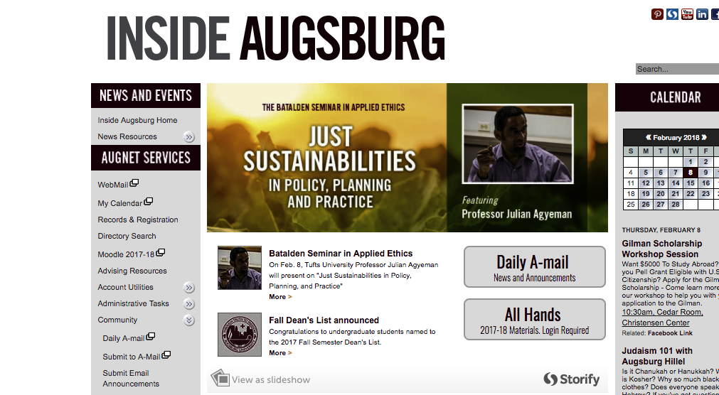
Important Online Forms & Documents
Field Orientation Information 2018-2019
Non-Metro Field Orientation PowerPoint
Field Safety PowerPoint (you are required to review this)
Field Documents 2018-2019
Field Placement Timeline
Interview Questions
Student Choice of Placement Form
Field Manual
Field Safety Checklist
Assignment Form
Field Information, Forms and Documents, can be found at
www.augsburg.edu/msw/fieldwork
MSW Moodle Resource Page
* Check back often as new things are added!
* Questions? Contact Lydia or Laura.

Slide 4
Field Requirements
Hours to be completed
Minimum of 500 hours concentration year
Minimum of 420 hours in the foundation year
*Note that some agencies may require students to complete more than the minimum hours required by Augsburg. This is their prerogative and your agreement to accept that placement is your agreement to complete additional hours.
Length of placement
Foundation: Fall and Spring Semesters (until end of April)
Concentration Year: Fall and Spring Semesters (until end of April)
May stretch into the 1st summer session if field agency requires and with consultation from your field seminar instructor
*Block placements are not allowed (defined as 21-40 hours/week)
Successfully complete all field seminar class requirements
Obtain malpractice/liability insurance

Slide 5
What is Non-Metro?
Twin Cities Metro: Defined as all agencies within Anoka, Dakota, Hennepin, Ramsey and Washington counties, and county agencies ONLY in Carver, Chisago, and Scott counties
Non-Metro: All other

Slide 6
Securing a Field Placement
Clarify your educational and field internship goals
Review the field manual.
Consult IPT.
Consult with Laura and Lydia about field placements in your home communities if IPT does not have apt placement.
Laura or Lydia will make initial contact with agencies to confirm that they are accepting students
Student will then send cover letter and resume to agency
Before interview, consult hand-out with questions for field instructors
Once you have completed an interview, contact Laura (via e-mail) and inform her as to whom you interviewed, their phone number or e-mail, the agency name, and if you would like the placement
Laura will contact the agencies to determine if it is a match
You will then receive confirmation from Lydia. (If a match is not made, Laura will contact you.)
*Non-metro students may begin contacting agencies on March 16

Slide 7
Dual Relationships
Social workers who function as educators or field instructors for students should not engage in any dual or multiple relationships with students in which there is a risk of exploitation or potential harm to the student. Social work educators and field instructors are responsible for setting clear, appropriate, and culturally sensitive boundaries(Standard 3.02(d), NASW Code of Ethics).
When the placement occurs, the student and field instructor have the duty to disclose the existing relationship and its nature.

Slide 8
Can I Suggest a Field Placement?
Contact Laura or Lydia via e-mail with the name of the agency, a contact person (if you have a name), and the phone number (especially outside the metro area).
Laura or Lydia will contact the agency to see if they meet Augsburg and CSWE accreditation guidelines.
Please allow the field staff to do this exploration, i.e. do not contact them.

Slide 9
Employment Site Placements
Refer to the field manual in terms of the proposal’s components.
Must have different roles & responsibilities than your job.
Field and employment hours must be distinct.
No cross-over of clients.
Field instructor and employment supervisor cannot be the same person.
One year employment at the agency.

Slide 10
Remember...
The goal is to have a placement by the end of May.
Act professionally. Your behavior toward all staff at an agency will reflect on all of us at Augsburg.
If you decide to not attend an interview, call and cancel.
You must get the placement. We just facilitate the placement process.
Not procuring a placement will delay your progress in the MSW program.

Slide 11
Remember...
If the placement requires transporting of clients, ask if the agency will cover the liability or contact your own private insurance.
Most placements will conduct criminal background checks and they can refuse a field placement based upon the results.
MSW Field Coordinator assigns the field seminar classes due to travel constraints.

Slide 12
Advice from an alum that now interviews students:
Don’t self-disclose too much personal information.
Dress professionally.
Use spell check on your written materials.
When asked about how you build rapport, do not say by self-disclosing that the same thing has happened to you and you “understand.”
Well talk more about this in foundation methods for those of you who think this is how to join.

Slide 13
Contact Information
Laura Boisen
Stressed? Give me a call or e-mail
boisen@augsburg.edu
612.330.1439
Lydia Madden
madden@augsburg.edu
612.330.1189
E-Mail for fastest response from Laura or Lydia

Slide 14
Online Access to all your Field Resources
To access Augsburg’s MSW Field Manual and all important field forms and placement information:
Moodle, MSW Resource Site
Field placement descriptions are updated periodically on IPT (www.runipt.com ) so check back often for updates.
Each student’s individual Learning Agenda and Agreement is shared with the student, field instructor, and field faculty via Google Docs (a link to the Document is emailed to your student augsburg.edu account at the end of August). DO NOT COPY DOCUMENT TO ALTERNATIVE FORMATS. You must use the Google Doc provided. Contact Lydia if problems.
Important updates will always be posted at the MSW Resource Site and on IPT Augsburg Home Page

Slide 15
Screenshot of IPT Home Page

Slide 16
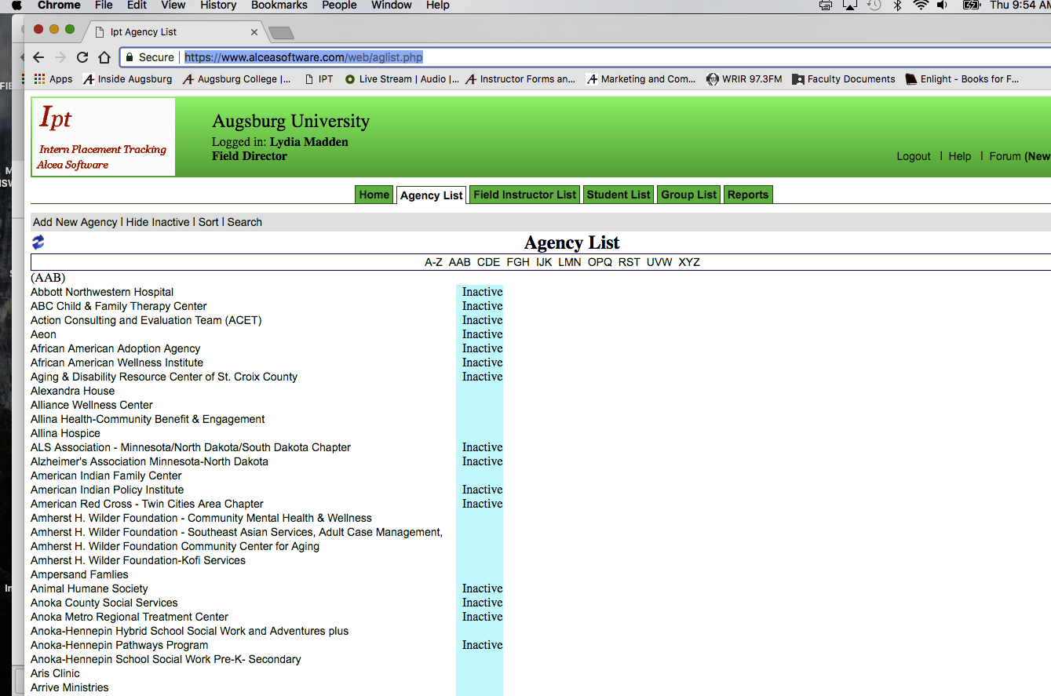
Screenshot of how you will see agencies listed in IPT
You are not able to see which agencies are NON-METRO on this page
To find NON-METRO agencies, you will need to use the Search Function

Slide 17
Screenshot of what you will see in IPT when you search for non-metro

Slide 18
Screenshot of what you will see when you view agency details (example)

Slide 19
Questions???
Thanks for coming!
Laura Boisen boisen@augsburg.edu
Lydia Madden madden@augsburg.edu

