Slide 1
Metro
Field Orientation

Slide 2
Field Contacts
Bibiana D. Koh: MSW Field Director
koh@augsburg.edu
612.330.1218
Lydia Madden: MSW Field Assistant
madden@augsburg.edu
612.330.1189

Slide 3
MSW Moodle Page: Field Resources
Field Orientation Information 2019-2020
Field Orientation PowerPoint
Field Safety PowerPoint (you are required to review this)
Field Documents 2019-2020
Field Placement Timeline
Interview Questions
Student Choice of Placement Form
Field Manual
Field Safety Checklist
Assignment Form
IPT Link for Placement Listings (updated frequently)
Non-Metro/Out of State
Metro Foundation
Metro MCCP
Metro MCMP

Slide 4
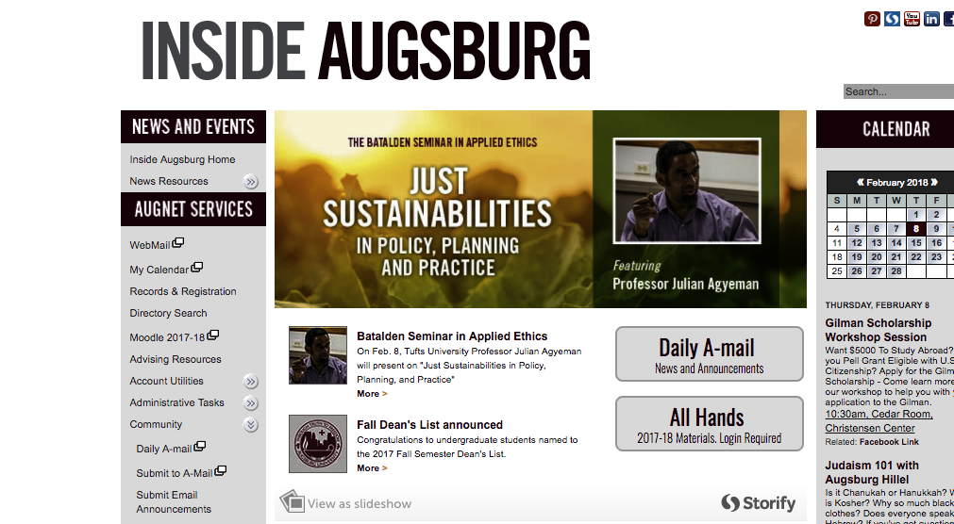
Important Online Forms & Documents
Go to InsideAugsburg
Select “My Courses 2019-20”
Click on MSW Resource Board
Check frequently got new information

Slide 5
Field Requirements
Hours to be completed
Foundation year: Minimum 420 hours
Concentration year: Minimum 500 hours
*Note that some agencies may require students to complete more than the minimum hours required by Augsburg. This is their prerogative and your agreement to accept that placement is your agreement to complete additional hours.
Length of placement
September to end of April)
May stretch into the 1st summer session if field agency requires and with consultation from your field seminar instructor
*Block placements are not allowed (defined as 21-40 hours/week)

Slide 6
Field Requirements, cont.
Successfully complete all field seminar class requirements (including a signed Learning Agenda at mid-term and final)
Obtain malpractice/liability insurance

Slide 7
Preparation Steps
Identify and clarify your educational and field internship goals
Review the MSW Field Manual
Review the approved placement field list available online on IPT www.runipt.com (review before contacting agencies):
*The list will include information such as special instructions (e.g., onboarding) internship hours, how the agencies want to be contacted, etc.

Slide 8
Preparation Steps, cont.
IPT – all inclusive (foundation, MCCP & MCMP placements )
Consult only those placements that fit your designation, i.e. foundation, MCCP or MCMP.
*Note: IPT will be updated periodically. See the IPT Home page for weekly announcements and news.

Slide 9
Preparation Steps, cont.
Resume: Prepare to distribute to prospective field instructors/agencies
Include categories such as education, employment, relevant volunteer experiences, and professional affiliations
Prepare an e-mail message highlighting your educational goals, interest in their placement, any relevant experience
May consult handout with questions for field instructors

Slide 10
Attend Field Fair
April 1st (3 - 5 p.m.) at the University of Minnesota Coffman Union – East Bank (you may want to park at Augsburg and walk)
Collaboration with the University of Minnesota SSW
Approximately 90 agencies in attendance
This will give those students in the greater metro area the opportunity to meeting with agencies of interest, distribute resumes and make appointments
Snacks!

Slide 11
Timelines: Metro Area
Metro: (defined as all agencies in Hennepin, Ramsey, Anoka, Dakota, & Washington Counties, as well as county agencies in Carver, Scott, and Chisago), you can contact field agencies via:
phone or email beginning April 1, afternoon
Interviews: April 1 – May 3 (unless there is special permission)
Your placement preference sheet is due to Professor Koh on May 6
Placement confirmation will come in late May. You will be notified of placement status via your augsburg.edu email.

Slide 12
How many interviews do I need to do?
The obvious answer is at least one - but many choose to do four interviews.
Ask yourself:
Have I found some placements of interest?
How competitive were the placements I chose (Professor Koh can give you a general idea of competitive placements historically)?
Word of caution: If “promised” a placement or told that you will be the number one choice, check with Professor Koh about whether more interviews should be completed.

Slide 13
What if I am not assigned a placement?
Don’t panic! This happens to a small percentage of students at all 3 schools - often some of the most talented students.
Late May: You will be emailed a list of available placements (we may discuss which might be a good fit for you).
Feedback: If there were interviewing problems shared by prospective field instructors, those concerns will be shared with you.
Less formal process: begins in late May – you contact prospective field instructor, interview, and discuss potential match.

Slide 14
Dual Relationships
Social workers who function as educators or field instructors for students should not engage in any dual or multiple relationships with students in which there is a risk of exploitation or potential harm to the student. Social work educators and field instructors are responsible for setting clear, appropriate, and culturally sensitive boundaries (Standard 3.02(d), NASW Code of Ethics).
When the placement occurs, the student and field instructor have the duty to disclose the existing relationship and its nature.

Slide 15
What if I want a placement that is not in IPT?
Contact Professor Koh via e-mail with the name of the agency, a contact person (if you have a name), and the phone number (especially outside the metro area).
Professor Koh will contact the agency to see if they meet Augsburg and CSWE accreditation guidelines.
Please allow the field staff to do this exploration, i.e. do not contact them yourself!

Slide 16
Employment Site Placements
Beginning of academic year – see field manual for proposal components
Must have different roles & responsibilities than your job.
Field and employment hours must be distinct.
No cross-over of clients.
Field instructor and employment supervisor cannot be the same person.
Minimum of one year employment at the agency.

Slide 17
Pathways: Washburn
Goals:
Increase the number of licensed mental health professionals from immigrant, refugee, & minority communities
Expand the accessibility of culturally competent, trauma-informed mental health services to members of diverse communities
Qualifications:
1st or 2nd year clinical track students only
$7500 stipend for students selected
Program Requirements:
Interview at Washburn & be accepted into the Pathways internship

Slide 18
Diversity Social Work Advancement Program (DSWAP)
Goals:
Increase the number of licensed mental health professionals from immigrant, refugee, minority & LGBT communities
Expand the accessibility of culturally competent, trauma-informed mental health services to members of diverse communities

Slide 19
Remember...
The goal is to have a placement by the end of May.
Act professionally. Your behavior toward all staff at an agency will reflect on all of us at Augsburg.
If you decide to not attend an interview, call and cancel.
You must get the placement. We just facilitate the placement process.
Not procuring a placement will delay your progress in the MSW program.

Slide 20
Also remember...
If the placement requires transporting of clients, ask if the agency will cover the liability or contact your own private insurance.
Most placements will conduct criminal background checks and they can refuse a field placement based upon the results.
MSW Field Director assign the field seminar classes due to travel constraints!
Once a placement is assigned, it is increasingly difficult to obtain another placement, e.g. if you’ve had 2nd thoughts or think you can do better somewhere else.

Slide 21
Advice from an alum that now interviews students:
Don’t self-disclose too much personal information.
Dress professionally.
Use spell check on your written materials.

Slide 22
Contact Information
Professor Koh
koh@augsburg.edu
E-mail is recommended for fastest response
Tel: 612.330.1218
Lydia Madden
Need help with IPT or Learning Agenda? Contact Lydia via email at
madden@augsburg.edu
Email is preferred for fastest response… but you can also call Lydia at
Tel: 612.330.1189

Slide 23
Online Access to Field Resources
To access Augsburg’s MSW Field Manual and all important field forms and placement information:
Moodle: MSW Resource Site
IPT: Updated periodically on IPT (www.runipt.com ) so check back frequently.
Learning Agenda: Shared with the student, field instructor, and field faculty via Google Docs (a link to the Document is emailed to your student augsburg.edu account at the end of August). DO NOT COPY DOCUMENT TO ALTERNATIVE FORMATS. You must use the Google Doc provided. Contact Lydia if problems.
Important updates see MSW Resource Site and IPT Augsburg Home Page

Slide 24
Screenshot of IPT Home Page
Notes:
Where the red arrow is pointing is where Lydia will list featured “agencies of the week” each week. The blue arrow is pointing to information that is also findable on MSW Resource Page on Moodle

Slide 25
Screenshot of how you will see agencies listed in IPT (Note: you should only see “active agencies)

Slide 26
Screenshot of what you will see when you view agency details
Notes:
Look for whether agency is looking for Foundation, MCCP, or other category. Read about what are the placement opportunities they are offering.

Slide 27
Questions???

