Slide 1
Metro
Field Orientation
How DO I get a field placement?

Slide 2
Field Contacts
Laura Boisen: MSW Field Coordinator
boisen@augsburg.edu
612.330.1439
Lydia Madden: MSW Field Assistant
madden@augsburg.edu
612.330.1189

Slide 3
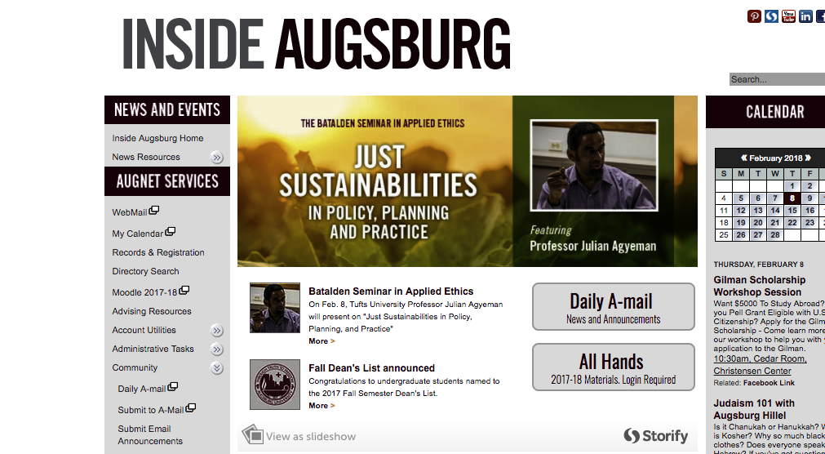
Important Online Forms & Documents
MSW Moodle Page: MSW FIELD RESOURCES & INFORMATION
Field Orientation Information 2018-2019
Field Orientation PowerPoint
Field Safety PowerPoint (you are required to review this)
Field Documents 2018-2019
Field Placement Timeline
Interview Questions
Student Choice of Placement Form
Field Manual
Field Safety Checklist
Assignment Form
IPT Link for Placement Listings (updated frequently)
Non-Metro/Out of State
Metro Foundation
Metro MCCP
Metro MCMP
Remember: the navigation to find this information is:
First go to InsideAugsburg, then choose My Courses 2018-19 , to find and click on
MSW Resource Board
Check back often as new things are added!

Slide 4
Field Requirements
Hours to be completed
Minimum of 500 hours concentration year
Minimum of 420 hours in the foundation year
*Note that some agencies may require students to complete more than the minimum hours required by Augsburg. This is their prerogative and your agreement to accept that placement is your agreement to complete additional hours.
Length of placement
Through 2nd semester (end of April)
May stretch into the 1st summer session if field agency requires and with consultation from your field seminar instructor
*Block placements are not allowed (defined as 21-40 hours/week)
Successfully complete all field seminar class requirements
Obtain malpractice/liability insurance

Slide 5
Preparation Steps
Clarify your educational and field internship goals
Review the field manual
Review the approved placement field list available online on IPT www.runipt.com (review before contacting agencies):
a) The list will include information such as special instructions (e.g. VA meeting), internship hours, how the agencies want to be contacted, etc.
IPT has all (foundation, MCCP & MCMP) placements included.
Consult only those placements that fit your designation, i.e. foundation, MCCP or MCMP.
*Note: IPT will be updated periodically. See the IPT Home page for weekly announcements and news.

Slide 6
Preparation Steps
Prepare a resume to distribute to prospective field instructors/agencies
Include categories such as education, employment, relevant volunteer experiences, and professional affiliations
Prepare an e-mail message highlighting your educational goals, interest in their placement, any relevant experience
May consult hand-out with questions for field instructors

Slide 7
Attend Field Fair
April 9th from 3 - 5 p.m. at the University of Minnesota, St. Paul Student Center | NorthStar Ballroom | 2017 Buford Avenue | St. Paul, MN 55108
Conducted in collaboration with the University of Minnesota SSW
Approximately 90 agencies in attendance
This will give those students in the greater metro area the opportunity to meeting with agencies of interest, distribute resumes and make appointments
Snacks!

Slide 8
Timelines-Metro Area
If you are in the metro area (defined as all agencies in Hennepin, Ramsey, Anoka, Dakota, & Washington Counties, as well as county agencies in Carver, Scott, and Chisago), you can contact field agencies via:
phone or email beginning April 9, afternoon
Interviews: April 10 – May 4 (unless there is special permission)
Your placement preference sheet is due to Laura Boisen on May 11
Placement confirmation will come in late May. You will be notified of placement status via your augsburg.edu email.

Slide 9
How many interviews do I need to do?
The obvious answer is at least one - but many choose to do four interviews.
Ask yourself:
Have I found some placements of interest?
How competitive were the placements I chose (Laura Boisen can give you a general idea of competitive placements historically)?
Word of caution: if “promised” a placement or told that you will be the number one choice, check with Laura about whether more interviews should be completed.

Slide 10
What if I am not assigned a placement?
Don’t panic. This happens to a small percentage of students at all 3 schools - often some of the most talented students.
You will be informed of the need for further contacts in an e-mail in late May.
If there were interviewing problems shared by prospective field instructors, those concerns will be shared with you.
A list of internships still without students will be distributed and we will discuss who might be a good fit for you.
A less formal process begins in late May where you contact the prospective field instructor, interview with them and we all talk right away about whether it is a match.

Slide 11
Dual Relationships
Social workers who function as educators or field instructors for students should not engage in any dual or multiple relationships with students in which there is a risk of exploitation or potential harm to the student. Social work educators and field instructors are responsible for setting clear, appropriate, and culturally sensitive boundaries (Standard 3.02(d), NASW Code of Ethics).
When the placement occurs, the student and field instructor have the duty to disclose the existing relationship and its nature.

Slide 12
What if I want a placement that is not on the list?
Contact Laura via e-mail with the name of the agency, a contact person (if you have a name), and the phone number (especially outside the metro area).
Laura will contact the agency to see if they meet Augsburg and CSWE accreditation guidelines.
Please allow the field staff to do this exploration, i.e. do not contact them yourself!

Slide 13
Employment Site Placements
Refer to the field manual in terms of the proposal’s components.
Must have different roles & responsibilities than your job.
Field and employment hours must be distinct.
No cross-over of clients.
Field instructor and employment supervisor cannot be the same person.
One year employment at the agency.

Slide 14
Pathways: Washburn
Goals:
Increase the number of licensed mental health professionals from immigrant, refugee, & minority communities
Expand the accessibility of culturally competent, trauma-informed mental health services to members of diverse communities
Applicant Qualifications
1st or 2nd year clinical track students only
$7500 stipend for students selected
Program Requirements
Interview at Washburn & be accepted into the Pathways internship

Slide 15
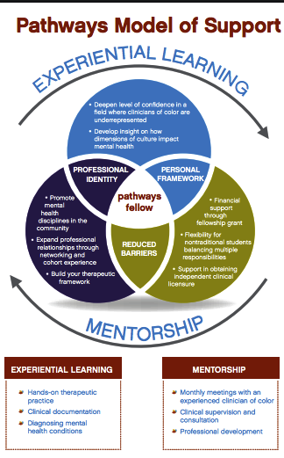
Pathways: Washburn

Slide 16
Diversity Social Work Advancement Program (DSWAP)
Goals:
Increase the number of licensed mental health professionals from immigrant, refugee, minority & LGBT communities
Expand the accessibility of culturally competent, trauma-informed mental health services to members of diverse communities
To apply, review IPT site: Family Partnership-DSWAP

Slide 17
Remember...
The goal is to have a placement by the end of May.
Act professionally. Your behavior toward all staff at an agency will reflect on all of us at Augsburg.
If you decide to not attend an interview, call and cancel.
You must get the placement. We just facilitate the placement process.
Not procuring a placement will delay your progress in the MSW program.

Slide 18
Remember...
If the placement requires transporting of clients, ask if the agency will cover the liability or contact your own private insurance.
Most placements will conduct criminal background checks and they can refuse a field placement based upon the results.
Field Coordinators assign the field seminar classes due to travel constraints.
Once a placement is assigned, it is increasingly difficult to obtain another placement, e.g. if you’ve had 2nd thoughts or think you can do better somewhere else.

Slide 19
Advice from an alum that now interviews students:
Don’t self-disclose too much personal information.
Dress professionally.
Use spell check on your written materials.

Slide 20
Contact Information
Laura Boisen
Stressed? Give me a call or e-mail
boisen@augsburg.edu
E-mail is recommended for fastest response
612.330.1439
Lydia Madden
Need help with IPT or Learning Agenda? Contact Lydia via email at
madden@augsburg.edu
Email is preferred for fastest response… but you can also call Lydia at
612.330.1189

Slide 21
Online Access to all your Field Resources
To access Augsburg’s MSW Field Manual and all important field forms and placement information:
Moodle, MSW Resource Site
Field placement descriptions are updated periodically on IPT (www.runipt.com ) so check back often for updates.
Each student’s individual Learning Agenda and Agreement is shared with the student, field instructor, and field faculty via Google Docs (a link to the Document is emailed to your student augsburg.edu account at the end of August). DO NOT COPY DOCUMENT TO ALTERNATIVE FORMATS. You must use the Google Doc provided. Contact Lydia if problems.
Important updates will always be posted at the MSW Resource Site and on IPT Augsburg Home Page

Slide 22
Screenshot of IPT Home Page
Notes:
Where the red arrow is pointing is where Lydia will list featured “agencies of the week” each week. The blue arrow is pointing to information that is also findable on MSW Resource Page on Moodle

Slide 23
Screenshot of how you will see agencies listed in IPT (Note: you should only see “active agencies)

Slide 24
Screenshot of what you will see when you view agency details
Notes:
Look for whether agency is looking for Foundation, MCCP, or other category. Read about what are the placement opportunities they are offering.

Slide 25
Email with your IPT default log-in information
From: Lydia Madden <emailer@runipt.com> Date: March 24, 2018 at 10:35:36 AM CDT To: JaneDoe@gmail.com Subject: Ipt Password Reset Reply-To: madden@augsburg.edu Your IPT user name and password have been reset to default values. Use the following information to login to IPT and set your own user name and password Organization: augsburg User Name: HBN7975K (is case sensitive) Password: ipt (is case sensitive) Login at www.runipt.com
Notes:
Look for whether agency is looking for Foundation, MCCP, or other category. Read about what are the placement opportunities they are offering.

Slide 26
Questions???

