Slide 1
Field Instructor Welcome & Orientation
Department of Social Work
August 26, 2022

Slide 2
Today’s Agenda
Topics & Activities
Goals:
Introductions
Small group discussions
Field Education as “Signature Pedagogy”
Field Roles & Supervision
EPAS expectations & learning activities
Field Challenges
Field Education and COVID
Small group discussion
Q & A
Become familiar with the people and processes involved in Field Education at the social work department at Augsburg University.
Review the basic social work competencies outlined by the Council on Social Work Education, and discuss ways to observe and evaluate competencies in practice.

Slide 3
AUGSBURG UNIVERSITY: WHO ARE WE?
Augsburg University educates students to be informed citizens, thoughtful stewards, critical thinkers, and responsible leaders.
The Augsburg experience is supported by an engaged community that is committed to intentional diversity in its life and work. An Augsburg education is defined by excellence in the liberal arts and professional studies, guided by the faith and values of the Lutheran Church, and shaped by its urban and global settings.
Notes:
Augsburg’s values echo social work’s; it’s exciting to teach and practice social work within an university that embraces our values; our president has talked about wanting Augsburg to function like a settlement house.

Slide 4
AUGSBURG MSW PROGRAM MISSION
We strive to prepare exceptional social work professionals for anti-racist and anti-oppressive advanced social work practice that promotes intersectional racial and social justice in a diverse and global society.
Notes:
We revised our mission last year – moving away from “multiculturalism” and into anti-racism and anti-oppression

Slide 5
AUGSBURG BSW PROGRAM MISSION
In striving for excellence, we aim to prepare social work professionals for generalist practice that promotes intersectional racial and social justice towards the well-being of people in a diverse and global society.

Slide 6
We are dedicated to maintaining positive relationships and connections to field instructors and their workplaces.
We seek ethical practice, not perfection.
We seek willing partners who wish to grow and learn in social work education.
AUGSBURG UNIVERSITY’S FIELD PROGRAM’S VALUES
Notes:
We hope that you are also growing and learning through the process of working with our students & our program.

Slide 7
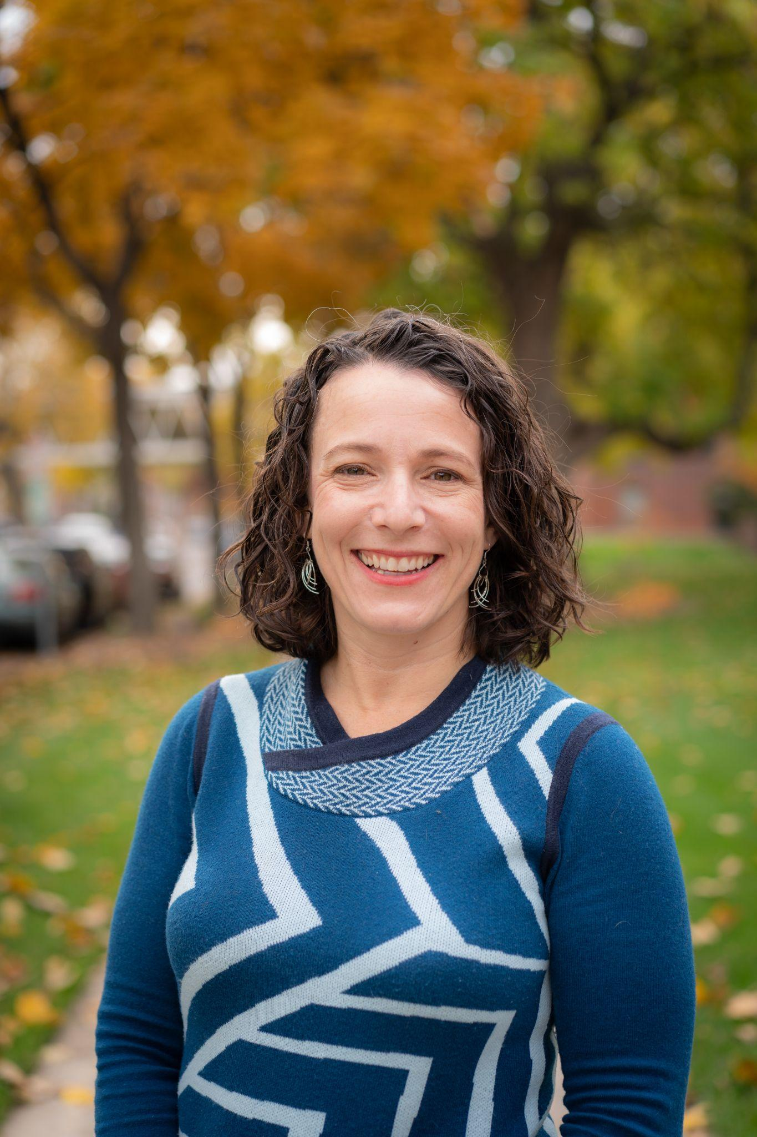
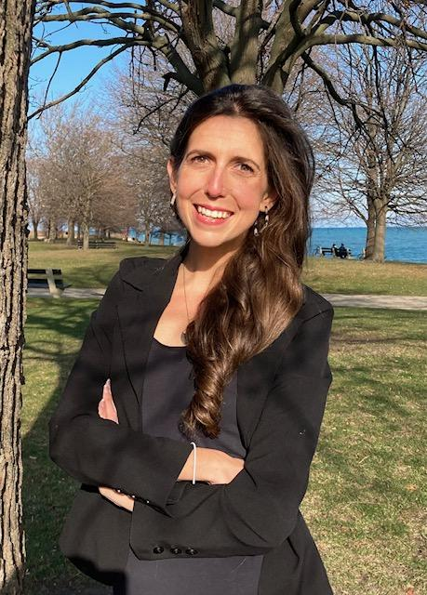
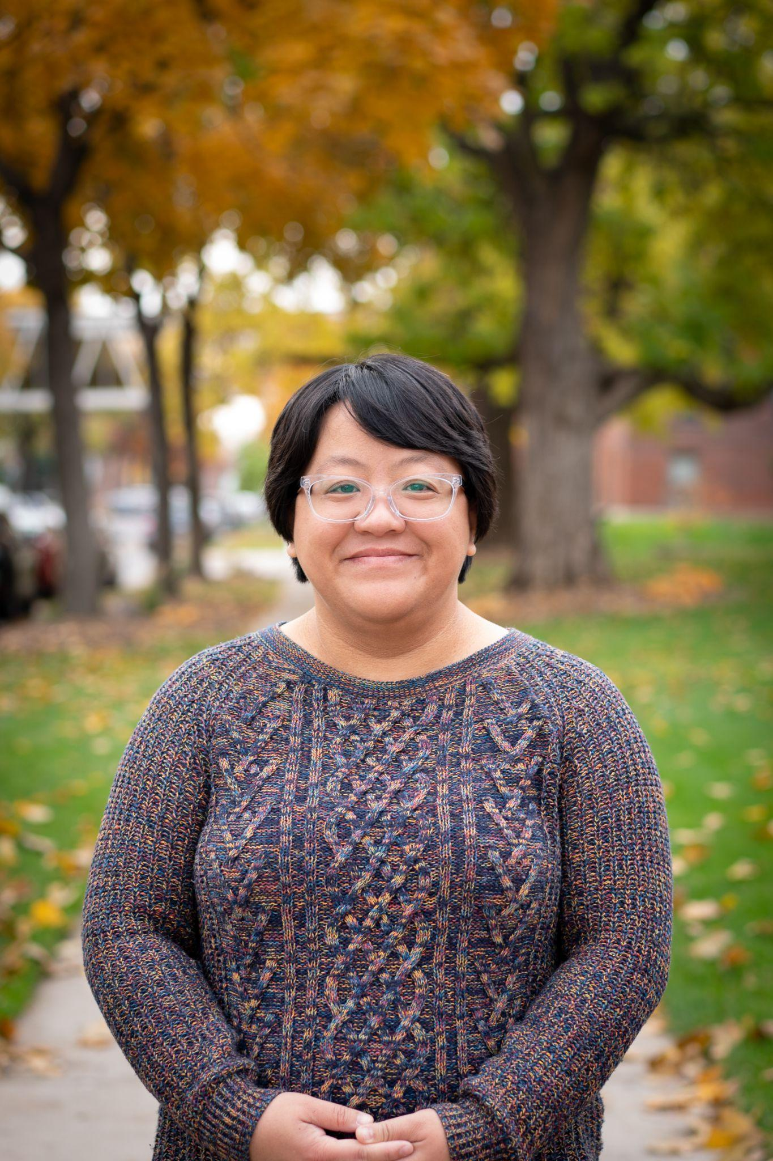
AUGSBURG SOCIAL WORK FIELD FACULTY & STAFF
Lydia Madden
MSW Field Program Coordinator
Dr. Erin Sugrue,
MSW Field Director
Dr.Johanna Reiter
Field Education Coordinator
Doran Edwards
BSW Program Assistant Director
Dr.Kao Nou Moua,
BSW Field Director

Slide 8
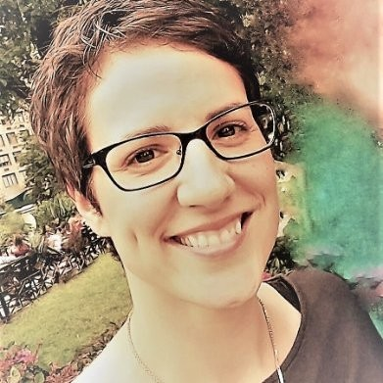
Field Seminar Faculty - BSW
Junior Field
Senior Field
Dr.Johanna Reiter, LICSW
Erika Fortin, LICSW
Richard Spratt, LICSW

Slide 9
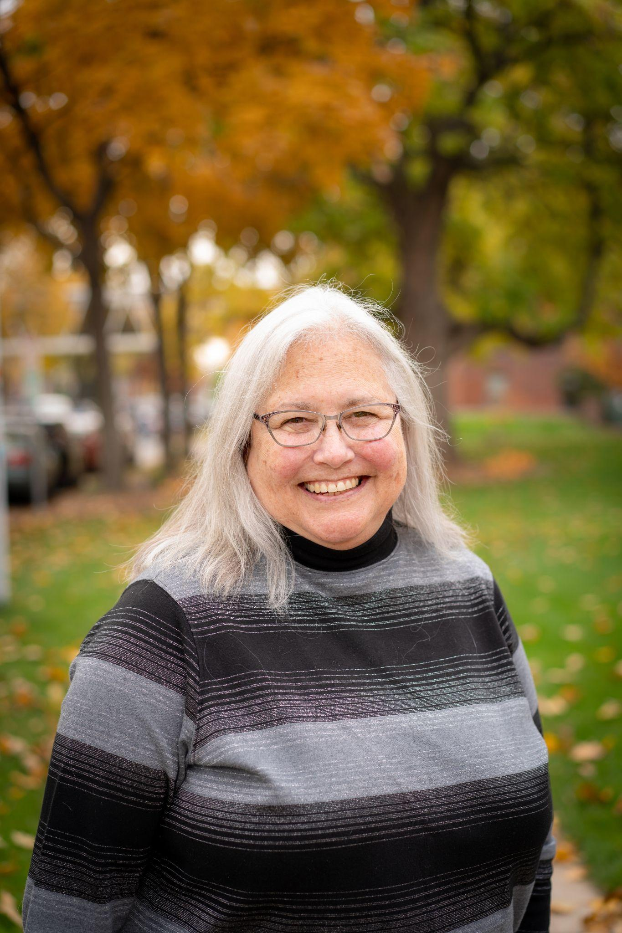
FIELD SEMINAR FACULTY -
MSW - GENERALIST*
Susan Carlin, LICSW
Dr. Alex Fink, LGSW
Richard Spratt, LICSW
*aka “foundation”

Slide 10
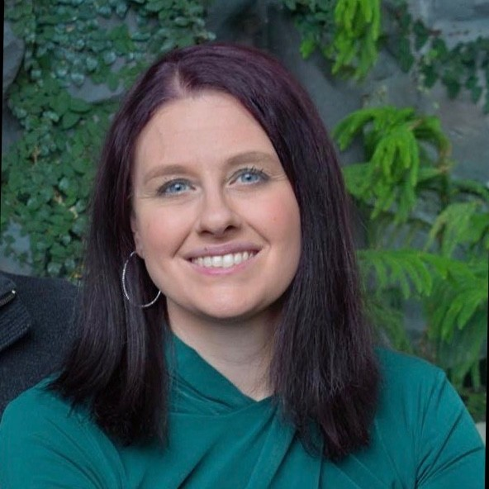
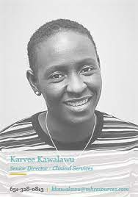
FIELD SEMINAR FACULTY -
MSW, CLINICAL SPECIALIZATION
Dr. Erin Sugrue, LICSW,
Kelsey Place, LICSW
Dr.Johanna Reiter, LICSW
Karvee Kawalawu, LGSW

Slide 11
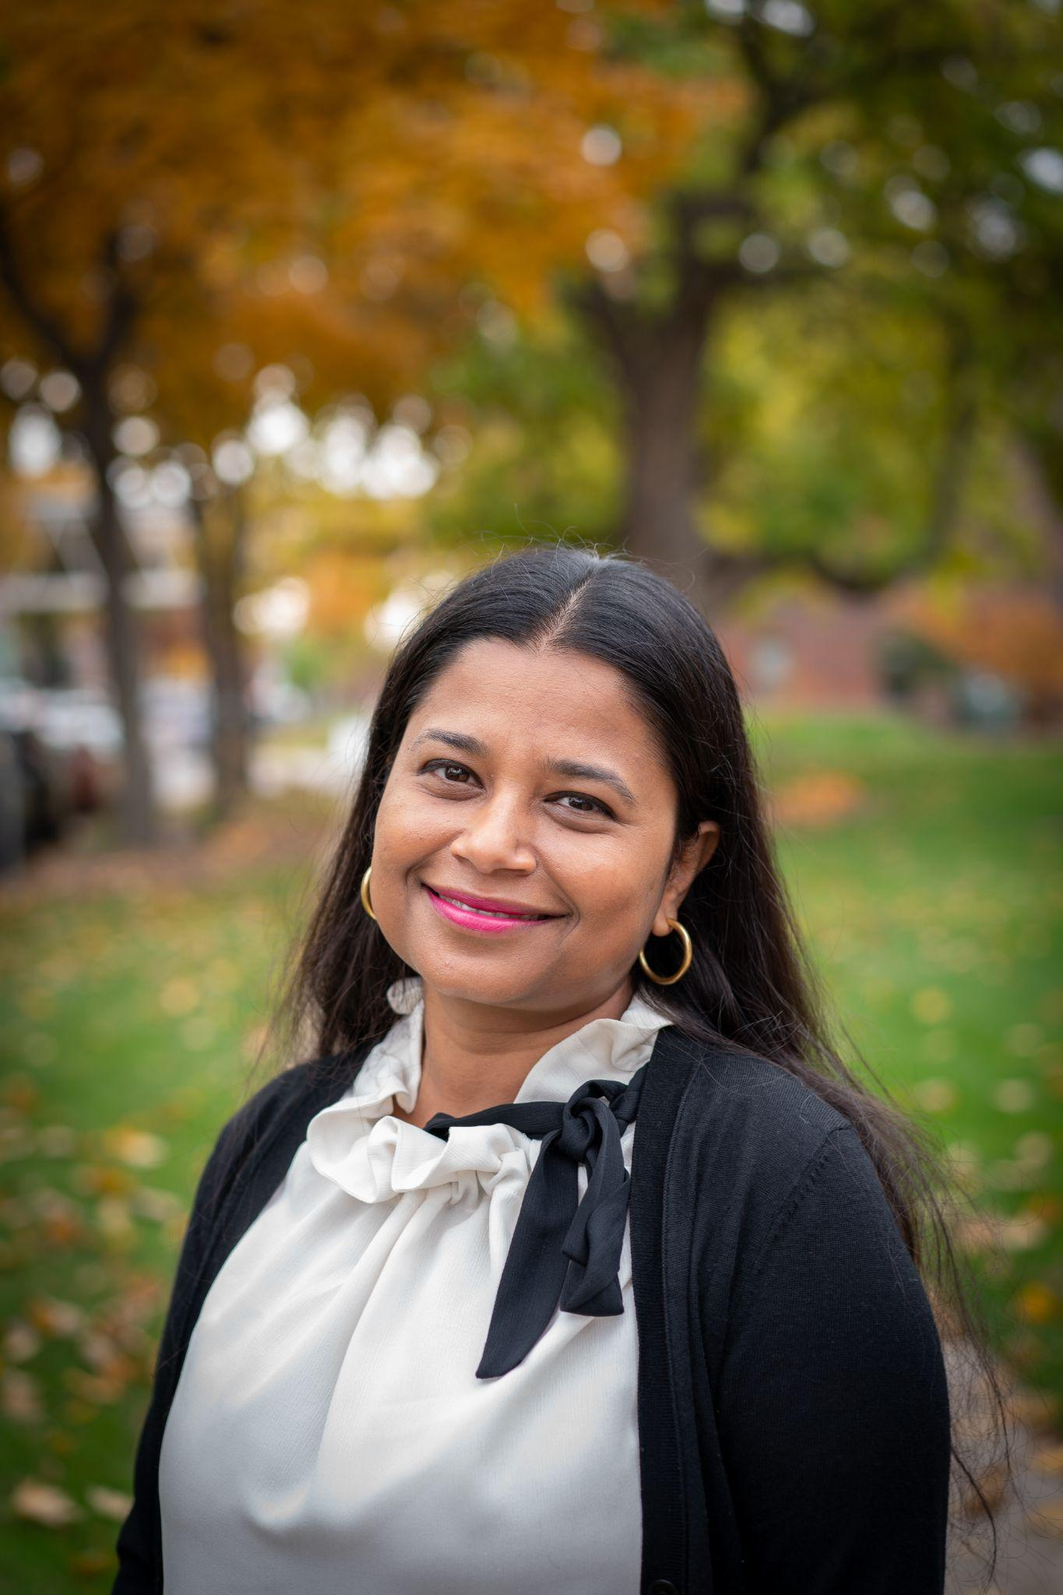
FIELD SEMINAR FACULTY -
MSW, MACRO SPECIALIZATION
Dr. Ankita Deka, LGSW

Slide 12
SMALL GROUP DISCUSSION
Your name, organizational affiliation.
Your social work supervisory role
What do you like about your role? If this is the first time you are supervising a social work intern, what are you looking forward to?
What do you think are some specific qualities of a good supervisor?

Slide 13
SOCIAL WORK’S
“SIGNATURE PEDAGOGY”
Notes:
What is meant by “signature pedagogy”?
Signature pedagogy represents the central form of instruction and learning in which a profession socializes its students to perform the role of practitioner. (Shulman, 2005, quoted in CSWE, 2008)
In social work, classroom learning and field learning are equally valued.
How do we maximize student learning in the practicum/internship?
Field education is systematically designed, supervised, coordinated, and evaluated based on criteria by which students demonstrate the achievement of program competencies. (CSWE, 2008)
Explain how we integrate field & coursework at Augsburg. TT faculty teach in our field seminars; we don’t have separate field staff/field faculty

Slide 14
SOCIAL WORK’S “SIGNATURE PEDAGOGY”
Field education is an essential element of professional social work training.
At Augsburg, students are required to complete the following number of hours in their practicum/internship:
BSW Junior: 240 hours
BSW Senior: 240 hours
MSW Generalist: 420 hours
MSW Specialization: 500 hours
These are MINIMUM requirements
MSW students: MAX of 24 hours/week
BSW students: Typically work 10-12 hours/week
Students may not finish their internship earlier than the last two weeks of the spring semester (end of April).
MSW students with Advanced Standing (BSW from an accredited program) need only the Specialist practicum.

Slide 15
WHO’S WHO?
Field instructor: A licensed social worker with a degree from an accredited program, who provides a student with one hour of supervision per week for the duration of the student’s practicum.
MSW Field Instructor: Licensed MSW with 2 or more years’ experience.
BSW Field Instructor: Licensed BSW with 3 or more years’ experience. Licensed MSW with 2 or more years’ experience.
Task supervisor (optional): On-site staff who supervises a student for no more than two of the four required hours per month. Does not need a social work degree or licensure (must have relevant education), as long as there is a field instructor who meets criteria.

Slide 16
MORE WHO’S WHO?
Field Directors: These are the faculty who lead and coordinate the BSW field education and MSW field education programs.
BSW Field Director: Dr. Kao Nou Moua
MSW Field Director: Dr. Erin Sugrue
Field faculty liaison (also called field education seminar instructor): This is a faculty member who teaches the required seminar course that students take concurrently with their practicum. The faculty serves as liaison between the practicum site and the university.

Slide 17
WHAT ARE STUDENTS SUPPOSED TO BE LEARNING IN THEIR FIELD PLACEMENTS?
Our learning agenda, which enumerates practice behaviors for students to learn and practice during their practicum, is based on the social work competencies outlined by the Council on Social Work Education.
These are known as the “EPAS” competencies (Educational Policy and Accreditation Standards).
Students’ tasks in practicum should be based on these competencies, but will be individualized based on the student’s learning needs, the nature of the organization in which the student is working, as well as their level of practice.
Notes:
W

Slide 18
COUNCIL ON SOCIAL WORK EDUCATION COMPETENCIES
1. Demonstrate Ethical and Professional Behavior | 2. Engage Diversity and Difference in Practice | 3. Advance Human Rights and Social, Economic, and Environmental Justice
4. Engage in Practice-Informed Research and Research-Informed Practice | 5. Engage in Policy Practice | 6. Engagement with Individuals, Families, Groups, Organizations, and/or Communities
7. Assessment of Individuals, Families, Groups, Organizations, and/or Communities | 8. Intervention with Individuals, Families, Groups, Organizations, and/or Communities | 9. Evaluate Practice with Individuals, Families, Groups, Organizations, and Communities
Citation: Greg Merrill, Director of Field Education, University of California - Berkeley School of Social Work
Notes:
These are the 2015 competencies; new ones will be released in 2022 - but don’t have to be fully implemented until 2024 - thus, we are using these this year.
I ask audience members to pick 3 competencies that are very easily addressed in their setting and 3 competencies that will take some thinking through. If time permits, I put them in groups of 3 to brainstorm how to address the “harder” competencies for field practicum.

Slide 19
SMALL GROUP:
Pick 3 competencies that are easily addressed in your setting and 3 competencies that will take some thinking through
Brainstorm in your groups how to address the “harder” competencies
1. Demonstrate Ethical and Professional Behavior | 2. Engage Diversity and Difference in Practice | 3. Advance Human Rights and Social, Economic, and Environmental Justice
4. Engage in Practice-Informed Research and Research-Informed Practice | 5. Engage in Policy Practice | 6. Engagement with Individuals, Families, Groups, Organizations, and/or Communities
7. Assessment of Individuals, Families, Groups, Organizations, and/or Communities | 8. Intervention with Individuals, Families, Groups, Organizations, and/or Communities | 9. Evaluate Practice with Individuals, Families, Groups, Organizations, and Communities
Citation: Greg Merrill, Director of Field Education, University of California - Berkeley School of Social Work
Notes:
These are the 2015 competencies; new ones will be released in 2022 - but don’t have to be fully implemented until 2024 - thus, we are using these this year.
I ask audience members to pick 3 competencies that are very easily addressed in their setting and 3 competencies that will take some thinking through. If time permits, I put them in groups of 3 to brainstorm how to address the “harder” competencies for field practicum.

Slide 20
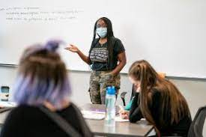
HOW DO STUDENTS LEARN?
The common thread of the social work practicum is that students learn by experience.
What is meant by experiential learning?
Learning about a task or method
Shadowing a more experienced worker
Practicing the task or behavior
Reflecting on one’s practice and skills
Students learn best through a combination of “learning by thinking” and “learning by doing” (Lee & Fortune, 2013).

Slide 21
BEST PRACTICES IN FIELD INSTRUCTION
Clearly Identified Outcomes and Purpose
Strong, attuned, personalized instructional relationship and learning environment
Opportunities to observe, do and be observed doing practice
Provision of feedback that is observationally based, balanced, and specific
Opportunity to reflect including self-reflection and integration of the conceptual and actual
Citation: Greg Merrill, Director of Field Education, University of California - Berkeley School of Social Work
Notes:
Literature suggests that several key practices are most successful in growing competent social workers: 1. Being really clear about the competencies you expect to see over time in your setting so that there is a clear learning target; 2. Creating a strong, attuned instructional relationship, setting the learning environment, and assessing your student; 3. Creating opportunities for them to observe, do, and be observed doing a wide range of competency-based tasks; 4. Providing regular performance-based feedback that is balanced and specific; and 5. Offering regular opportunities for self-reflection as well as for integration of knowledge including applied ethics and theory, social scientific knowledge, community wisdom, and practice wisdom. This last part helps the student to learn how to independently think for themselves.

Slide 22
GOOD STARTS
Time for a planned, thoughtful orientation (3-4 weeks)
Time for the student to understand day-to-day operations and all of the multi-level agency, community, and social/economic factors that shape service delivery
Time to review of all relevant safety and risk reduction policies as well as client confidentiality and privacy policies
Time to make your expectations and availability clear
Time to assess relevant knowledge, skills, and attitudes, hopes and fears, style of learning, and personal, temperamental, cultural, and/or identity related factors that may inform how they approach
Time to map out tasks that are agency-based, competency-based, and assessment-based
Citation: Greg Merrill, Director of Field Education, University of California - Berkeley School of Social Work
Notes:
This slide re-hashes some of the material from the prior slide. I usually use it to highlight the critical importance of orienting the student to privacy of client information in the internship setting AND to identify all of the safety risks as well as risk reduction practices and

Slide 23
VYGOTSKY’S ZONE OF PROXIMAL DEVELOPMENT
Beyond capacity to do
Can do with instruction
Can do without assistance
Citation: Greg Merrill, Director of Field Education, University of California - Berkeley School of Social Work
Notes:
To be an instructor means to help people do things well that they could not previously do well. This requires assessment and it also requires strategic scaffolding so that their development can emerge into the next level or two. If you ask a student to do what is well beyond their capacity, they can become overwhelmed and paralyzed and lose self-efficacy. The trick is to find that “just right” growth zone.

Slide 24
THOUGHTFUL TASK SELECTION
Agency Needs
Student Learning Needs
Key Variables:
Quantity
Range
Just Right
Complexity
Citation: Greg Merrill, Director of Field Education, University of California - Berkeley School of Social Work
Notes:
For an internship to be viable, sustainable, and mutually beneficial, the intersection between what the agency needs done and what the student needs to learn needs to be mined.
When assigning tasks, consider the quantity or increment (scale to the student’s service hours per week), the range (to make sure all ecosystems are touched upon, all competencies, and all phases of the intervention cycle), and the complexity (“just right” in the student’s growth zone but not in their comfort or panic zone).
This is both an art and a science!

Slide 25
STUDENT LEARNING:
THE CRITICAL ROLE OF SUPERVISION
Students should receive one hour of supervision per week (approx. 4 hours/month)
For settings with a field instructor and a task supervisor, supervision should include at least 2 hours/month with the licensed field instructor (the remaining hours can be done by the task supervisor).
For settings that offer group supervision, supervision should include at least 2 hours/month of individual supervision.

Slide 26
COMMIT TO THE WEEKLY INSTRUCTIONAL HOUR
Establish a regular, expected time
Encourage the student to develop the agenda (and it is also a good idea to have your own)
Pro-actively review administrative and orienting information
Consult about problems, challenges, and successes
Ask questions that invite self-reflection and learning integration
Share your practice wisdom as it applies
Link to professional values, theories, and knowledge (e.g. what might your practice methods instructor say about this?)
Provide support and encouragement and direct feedback
Vary what you are doing as student grows more capable
Evaluate how the weekly hour went and how it could be improved the following week
Citation: Greg Merrill, Director of Field Education, University of California - Berkeley School of Social Work
Notes:
One of the greatest predictors (not the only one but a significant one, for sure) in my experience of how well an internship goes has to do with the consistency of the instructional hour every week. Commit to it now. Schedule a home time as soon as possible and carve out that sacred place in your busy schedule. Having a home time allows students to bind anxiety between instructional hours and gives them a sense of predictability in a sea of anxiety. The second greatest predictor is probably how that time is used and if your instructional style attunes to the student’s learning needs and style. In other words, different students will need a really different hour.
If time permits, you can have field instructors meet in dyads or triads to share how they might structure the instructional hour.

Slide 27
REFLECTION AND INTEGRATION AS THE INTERNSHIP EVOLVES
Requires consistent weekly time to look at the big picture together beyond day-to-day procedures and tasks
Involves wide-ranging discussions:
What’s coming up for you?
What factors related to social justice should we consider?
What are the most relevant values, ethics, and moral principles here?
How would you assess the available knowledge or
evidence?
What do you think is the best decision? What’s your reasoning?
What skills would you need to implement this?
What reactions and emotions might get in the way?
Citation: Greg Merrill, Director of Field Education, University of California - Berkeley School of Social Work

Slide 28
THE LEARNING AGENDA: NUTS & BOLTS
Augsburg Learning Agendas are in GoogleSheets.
You will receive an e-mail in late August/early September from the Social Work Department with a link to the form for your student.
Having the agenda on GoogleSheets helps ensure consistency while also allowing the field instructor and student to individualize practicum tasks.
If you cannot access GoogleSheets at your work place, your student can access the form using their Augsburg or Gmail e-mail account.
Students and field instructors MUST NOT download the learning agenda or try to recreate it in a different format. All of the learning activities and ratings/comments must be made IN THE GOOGLE SHEET.
Please do not make any edits to the Learning Agenda’s structure (e.g. do not attempt to add additional rows to the document).

Slide 29
We know our learning agenda format could use some revision . . .
Notes:
We know that currently our learning agenda format is quite cumbersome and the least favorite format among the metro programs (according to many field instructors). We are currently in the process of re-accredidation and we use our learning agendas for the signfriciant amount of data collection we must engage in and provide to CSWE. We cannot make any changes to our format THIS YEAR (due to the accreditation process) but please know we’ve heard your feedback and post-accreditation, revising the learning agenda will be on the list.
Open up to questions about the learning agenda - thoughts how to make it most useful and least cumbersome?

Slide 30
FIELD VISITS
Field faculty meet with agency-level field instructors and their students three times during the course of the field experience.
Ideally, at least one of these should be an in-person visit*; the others can be conducted by Zoom.
Non-metro students will have all visits via Zoom.
Goals of Field Visits: discuss student learning goals and progress; address any concerns; provide feedback; coordinate support; nuts and bolts questions

Slide 31
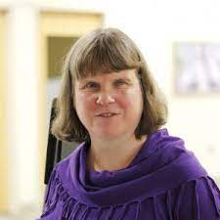
Disability Accommodations in Field Placements
Field placements are an educational setting, not an employment setting, and thus disability accommodation issues are the responsibility of Augsburg (the educational institution) and fall under Section 504 and not under the ADA.
If a student informs you that they are in need of accommodations in their field placement due to a disability (these include mental health diagnoses), please direct them to contact their field seminar instructor and Kathy McGillvray at Augsburg’s CLASS office, so that a formal accommodation plan can be developed and the student can have the appropriate support.
You should not develop your own accommodations with the student. You should inform the student that step one is to contact the CLASS office. The CLASS office and/or the Field Director will then follow up with you with information regarding the required accommodations.
Students are also receiving this information and are being STRONGLY ENCOURAGED to contact the CLASS office in the fall if they believe they MIGHT need accommodations in their field placement.
Kathy McGillivray, CLASS Office Director

Slide 32
WHAT IF PROBLEMS HAPPEN?
Prevention is the best strategy.
Early intervention is absolutely a must.
Good place to address areas of concern is supervision.
Documentation* and communication is crucial.
Notify the Field Seminar Faculty
The field faculty member may likely involve the Field Director - particularly if it relates to serious concerns.
On a bright side, most concerns can be addressed through adequate supervision and feedback.
Notes:
Like to have things documented in emails - even if the conversation is in person, sending a follow-up email, summarizing the points and plans for next steps.
We don’t want to be surprised at the end of the semester or, especially the year, that the student is not passing.

Slide 33
WHAT IF I HAVE QUESTIONS?
Lydia Madden, Department Administrator, is available to answer questions via e-mail (madden@augsburg.edu) or phone (612-330-1189).
If you have questions about appropriate tasks or learning outcomes, your student’s field seminar faculty can provide guidance. Your student should know the name and contact information for their field faculty instructor. This information is also on the syllabus for the Field Education Seminar course.
If a situation needs more attention, the Field Directors of the programs may be involved.

Slide 34
Field Education during COVID-19 (2022-2023 EDITION)

Slide 35
AUGSBURG UNIVERSITY COVID-19 POLICIES - FALL 2022
VACCINATION IS REQUIRED FOR ALL STUDENTS
(staff & faculty too)
Students must submit proof of having received 2 doses of Modera/Pfizer or 1 dose of J&J; OR
Submit a request for a medical or non-medical exemptions & receive approval
Augsburg Masking Policy
Masks are required for all students, faculty, and staff during in-person classes, regardless of vaccination status, until September 10th.
After September 10th, only unvaccinated individuals are required to mask.
Notes:
MASKS ARE NOT REQUIRED FOR VACCINATED INDIVIDUALS
MASKS ARE REQUIRED FOR UNVACCINATED INDIVIDUALS INDOORS ON CAMPUS

Slide 36
COVID POLICIES FOR AUGSBURG STUDENTS IN FIELD
**Through September 9th, students will be required to wear masks at their field placements (unless in a private office with no other coworkers or clients).
Whenever there is a mask mandate on campus, students must also mask at their field placements.
AUGSBURG STUDENTS WILL COMPLY WITH ANY ADDITIONAL COVID-19 PROTOCOLS REQUIRED BY THEIR AGENCIES (e.g. vaccination requirements, social distancing, cleaning protocols, etc.)
AGENCIES HOSTING AUGSBURG STUDENTS WILL BE EXPECTED TO COMPLY WITH ANY STATE AND/OR LOCAL ORDERS RE: COVID-19 PRECAUTIONS
Notes:
Field placements are an extension of the Augsburg classroom, hence, masking is required in all learning spaces
There may be a number of questions here.

Slide 38
QUESTIONS?

