Slide 1

Faculty Meeting
November 13, 2019

Slide 2
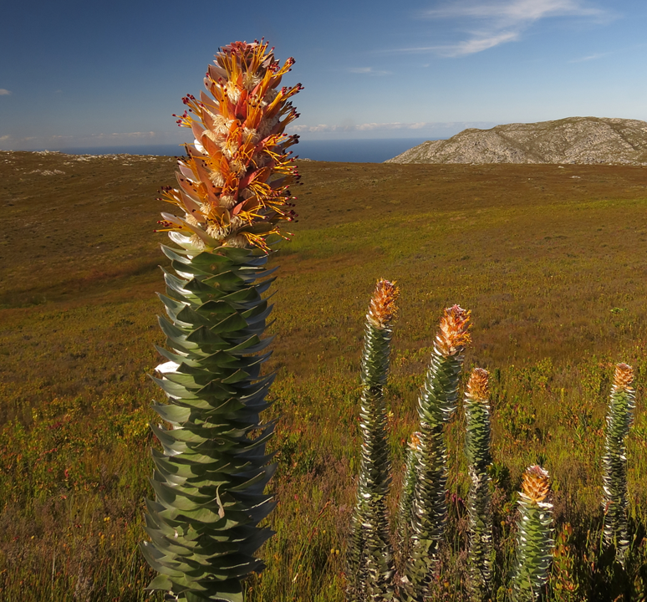

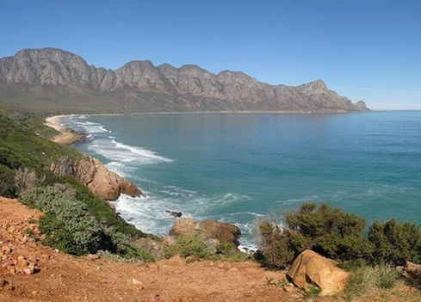
Mimetes stokoei
the mace pagoda

Slide 3
11.13.2019 - Agenda
First Word – Leon Van Eck, Assistant Professor of Biology
Approval of Minutes
Approval of Agenda
Announcements
  Course evaluation process reminder – Diane Pike, Scott Krajewski
Provost’s Report – Karen Kaivola
Faculty Senate Report – Milda Hedblom
General Education redesign update - Stacy Freiheit
(Re)framing issues raised in last month’s “open forum” – Katie Bishop
  “Student success” in historical perspective
  Teaching today’s students: key questions
  Small group discussion/reflection
Adjourn

Slide 4
(Re)framing issues
raised in last month’s “open forum”
_____
Katie Bishop
Chief Student Success Officer

Slide 5
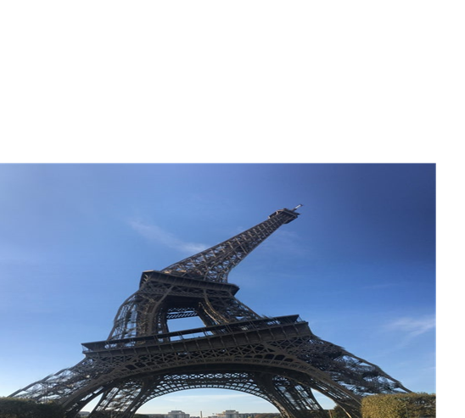
Structure

Slide 6
Class Status
Meyer v State of Nebraska (1923): “it is the natural duty of the parent to give his children education suitable to their station in life.”

Slide 7
Economic Disparity
Harry Hopkins, Director of Works Progress Administration, 1935:
“All this about anyone being able to go to school who wants to is sheer nonsense…I grant you there are a few exceptional students who can do it, but the great majority of people cannot; and anyone who knows anything about this game knows that in the good old days of 28 and 29 tens of thousands of young people were leaving school to go to work for no other reason than that they were poor.”

Slide 8
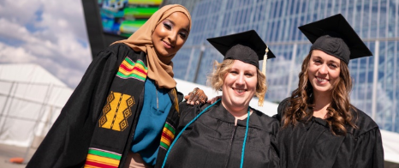
Higher Education Act, 1965
Federal programming to assist families in financing higher education:
•Pell Grants
•Work-Study
•Stafford Loans
•Perkins Loans (finished in 2017)

Slide 9
Emergence of Student Success Paradigm
Access = admissions and funding
Problem: as access to higher education increases for students who have been historically marginalized, rates of success (graduation, retention) go down.

Slide 10
Why?
John Dewey:
Schools are designed to reproduce societies, not transform them.
Vincent Tinto:
Low retention is tied to students’ failure to become incorporated into the intellectual and social life of the institution.
Paulo Friere:
“Education...is the practice of freedom, the means by which men and women deal critically and creatively with reality and discover how to participate in the transformation of their world.”

Slide 11
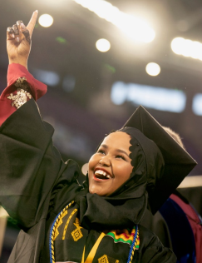
Student Success at Augsburg
Student success at Augsburg is about examining ourselves -- not what students are doing wrong, but how do we change in order to better partner with students.
We recognize the assets and strengths of
students within a system that has barriers.

Slide 12
Discussion:
Please reflect on the following questions and discuss in pairs or groups of three.
How do we move forward together to navigate these issues in ways that best meet the needs of the students in our classrooms?
What are your own immediate goals?
What keeps you awake at night when you think about these questions?
What would you propose as next steps - for you, for your department, for Augsburg?
Please jot down a key point from your reflection or discussion that you would like to share.

