Slide 1

Strategic Enrollment Management
Faculty Meeting-December 5, 2018
Robert Gould

Slide 2

Enrollment – Fall Updates
Spring & Fall 19 enrollment, admission assumptions
New Initiatives (Recruitment, Admission, Financial Aid)
Strategic Enrollment Management (Commission 150)
Notes:
Would like to cover the follow (read off) and then very open to any follow up discussion or feedback, I continue to be thankful for how we have been connecting to discuss our collective thoughts on strategic enrollment management. Thank you very much for the departments that have made time to share and connect with me on topics crucial to enrollment management. It will take us all seeing our strengths coupled with the urgency to collaborate and compete in driving demand for our offerings, based on our success thus far.

Slide 3
Spring 2019 enrollment, admission assumptions
(review of Fall 2018 results-tuition ONLY)

Slide 4
Spring 2019 enrollment, admission assumptions
(Spring 2019 Registration Trend as of 12/3/18)

Slide 5
Fall 2019 enrollment, admission assumptions
(New Day Application Trend as of 12/3/18)

Slide 6
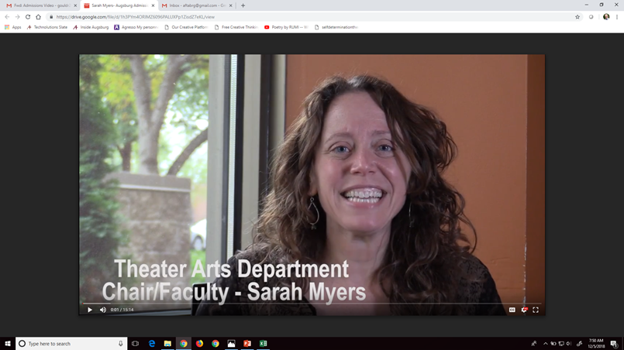




New Initiatives
(Recruitment, Admission, Financial Aid)
Co-Leadership culture
Program videos for (internal use) tours, recruitment etc.
Naviance, Zee Mee, Raise.me, Longmire Study
Financial Aid award brochure
Test Optional
Notes:
Robert- looking forward to collaborating on strategy getting feedback on plans, metrics quarterly, challenges, and successes

Slide 7
New Initiatives
(Co-Leadership for Admissions & Financial Aid)
VP Strategic Enrollment Mgt.
AVP for Performance Director of Fin AId
Associate Director (New Students)
Assoc Dir. (Returning Students)
AVP for Innovation Director of Graduate Amissions
Director of UG Admissions (New Day and Transfers)
Director of International Recruitment (Comm. Flow and Events)
Director (Technology)
Associate Director of UG Admissions-Transfers Day, Step-UP & AU (Recruitment)
Graduate Admissions (Recruitment)
Associate Director of UG Admissions-First Year Day (Recruitment)

Slide 8
New Initiatives
(Great Colleges To Work For
Enrollment Division Action Plan)
Improve NEXT Great Colleges To Work For Survey Results:
Create and orientation/on boarding process that both prepares new faculty and staff to the University and their specific department.
Encourage a culture of shared ideation and trust amongst departments that currently have the greatest need to work together.

Slide 9
New Initiatives
(Financial Aid Award –New Students)

Slide 10
New Initiatives
(Financial Aid Award –New Students)

Slide 11
New Initiatives
(Test Optional Implementation)
Thursday, January 31, 2019 3:40 – 5:40pm Screening of “The test and the art of thinking” https://www.imdb.com/title/tt6097886/videoplayer/vi309901337?ref_=vp_pl_0
ACCRAO-Consulting/Training for Admissions, Advising, and Trio staff
Financial Aid- no further adjustments for year one, tracking data to monitor impact to discount for future year adjustments
Faculty updates -will share data on participation, academic indicators, yield, first-year success

Slide 12
Strategic Enrollment Management
(Commission 150)
Collaborations
  Academic Plan
  Enrollment division alignment with Multicultural Student Services
  Honors and Fine Arts
  UC Net Revenue Growth Team
    -Day/Adult/Grad- Strengthen, Innovate, Grow
Undergraduate: market demand opportunities
  STEM, FINE ARTS, ATHLETICS
  Hagfors interdepartmental demand driver

Slide 13
Strategic Enrollment Management
(Commission 150)
Applicant completion impact- -5% drop from 2017, -19% drop from 2015
International Students- 9 new degree students
Augie Plan- 9 new students
Step-Up- 28 new students
Adult-Degree Completion- generally on track with lower revenue vs. prior FY
Graduate- successful fall with some exceeding goals
Spring 19 (target 75 new transfer, 10 new first year)

Slide 14
Strategic Enrollment Management
(UC Enrollment Committee)
Spring 2019 Charge/Strategic Focus
Strengthen the partnership between Admissions/Financial Aid (Day, Transfer, Adult, Graduate) and Augsburg faculty to recruit students to meet institutional goals.
Author an operational briefing that documents selected best practices/assessments for faculty to efficiently contribute to enrollment success for Augsburg. Deadline: March 1, 2019
    Recommend actionable items to contribute to fall 2019 admit to enrolled yield
    Recommend quality improvements that can be effective in student engagement during recruitment
    Recommend efficient and effective recruitment activities coupled with informative assessment/feedback loop.
    Recommend activities to ensure the faculty's awareness of the outward facing recruiting landscape.
    Explore potential transferable recommendations for staff, alumni, parents, and community members.

Slide 15
Strategic Enrollment Management
(UC Enrollment Committee)
Spring 2019 Charge/Strategic Focus
Co-develop a culture at Augsburg where faculty and staff understand the importance of enrollment management (both strategic and operational), and are empowered to take action.
Partake in an undergraduate enrollment management effectiveness review and recommend a set of actionable innovations. May 1, 2019 (Including but not limited to the following):
    Review, evaluate and recommended changes for enrollment management policies to meet institutional goals.
    Review enrollment management related research and make recommendations for further analysis or new research projects.
    Determine format and review routine enrollment performance data and recommend campus wide communication to ensure transparency
    Review and recommended enhancements to structural relationships between enrollment functions.
    Review and endorse the enrollment division's mission and guiding principles, and Strategic Enrollment Management descriptive definition for Augsburg.
    Similar initiative being completed by Graduate Counsel

