Slide 1

Provost’s Report
November 7, 2018

Slide 2


Slide 3

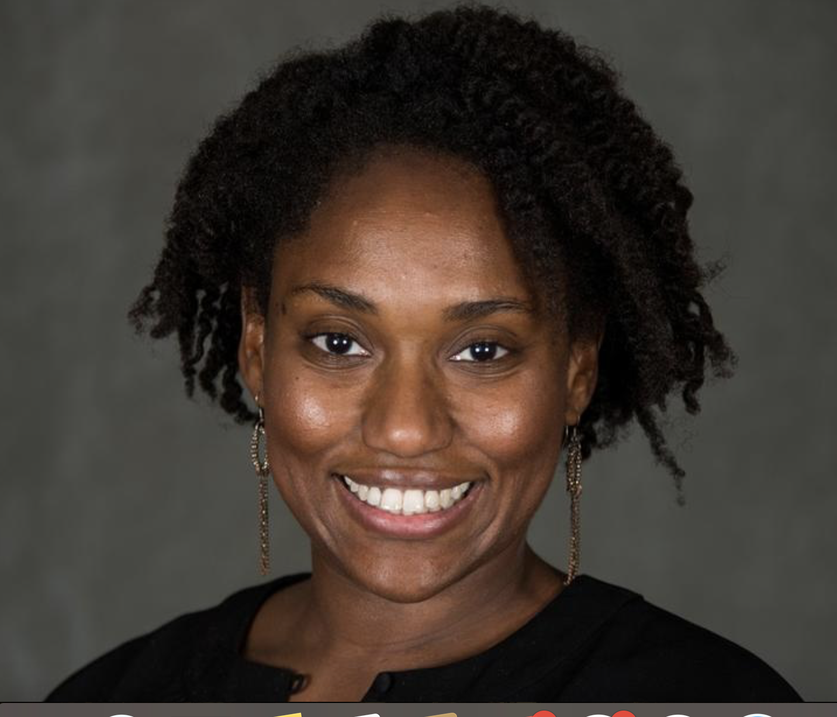

Slide 4


Slide 6
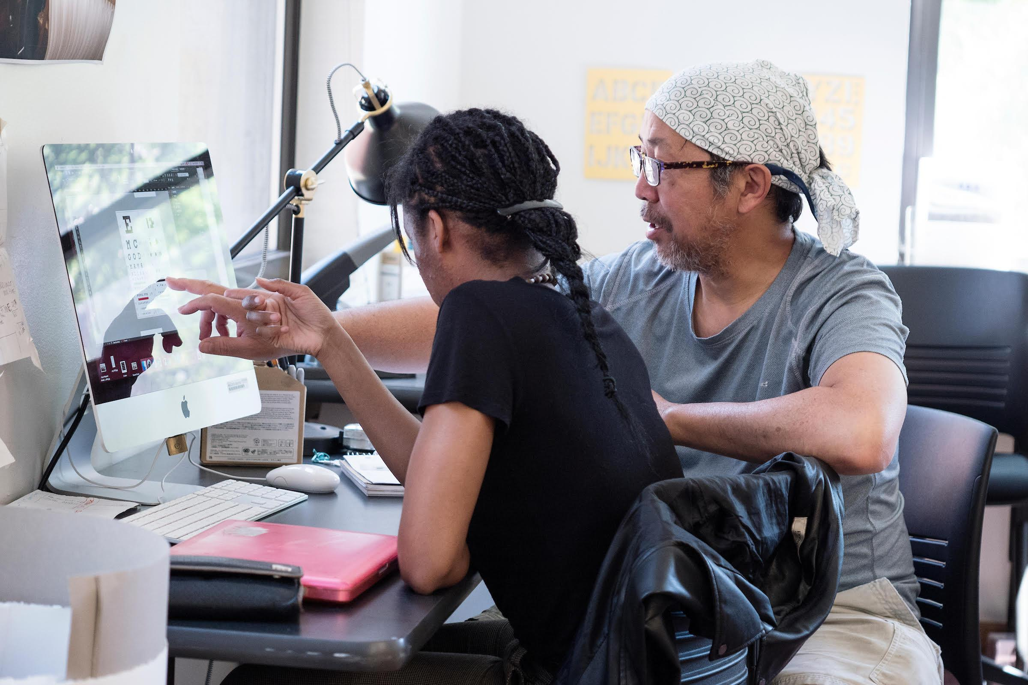
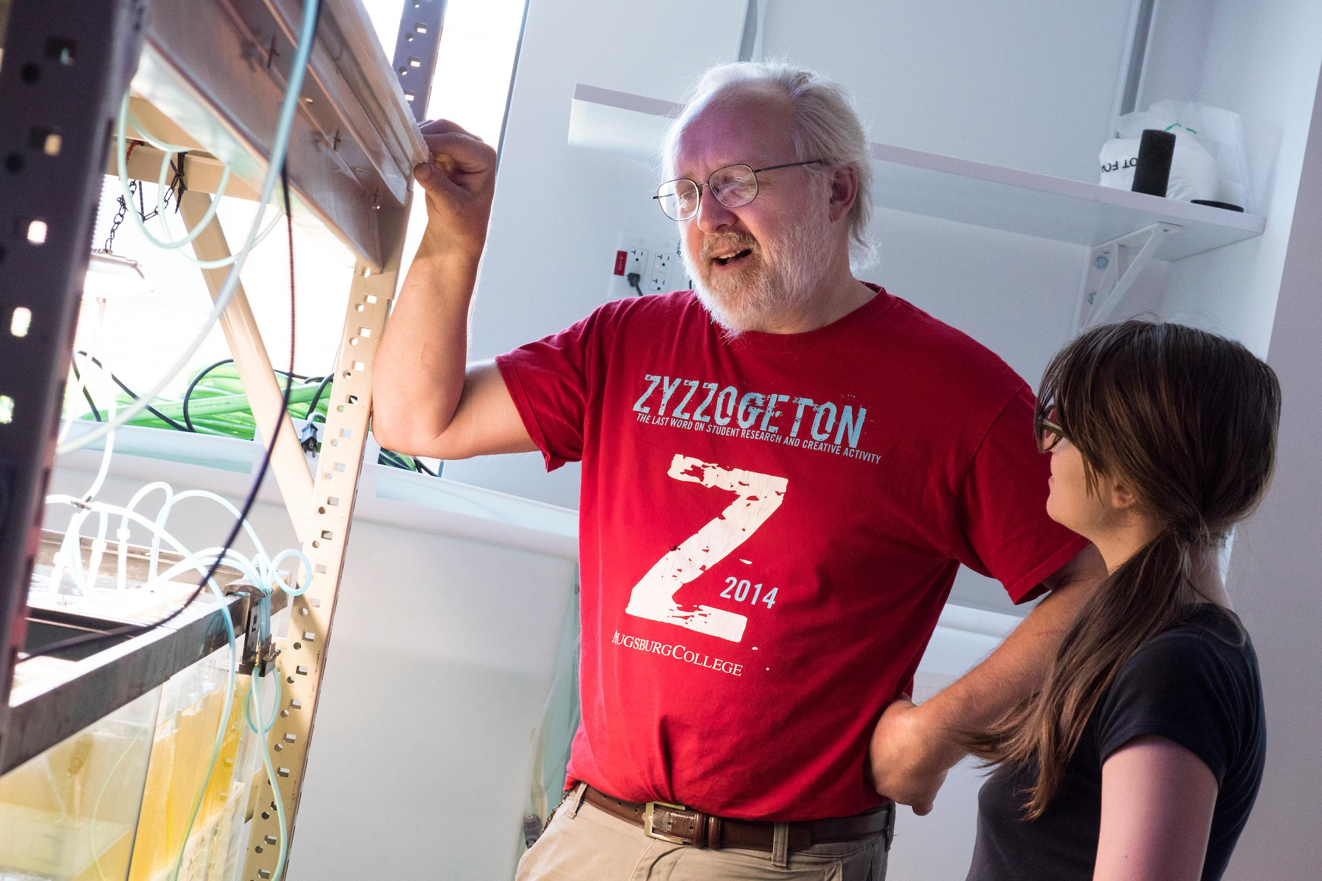

Slide 7
general education redesign

Slide 8

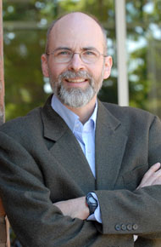

Slide 9
diversity, equity and inclusion
academic freedom
TRANSFORMING HIGHER EDUCATION (and ourselves)

Slide 10
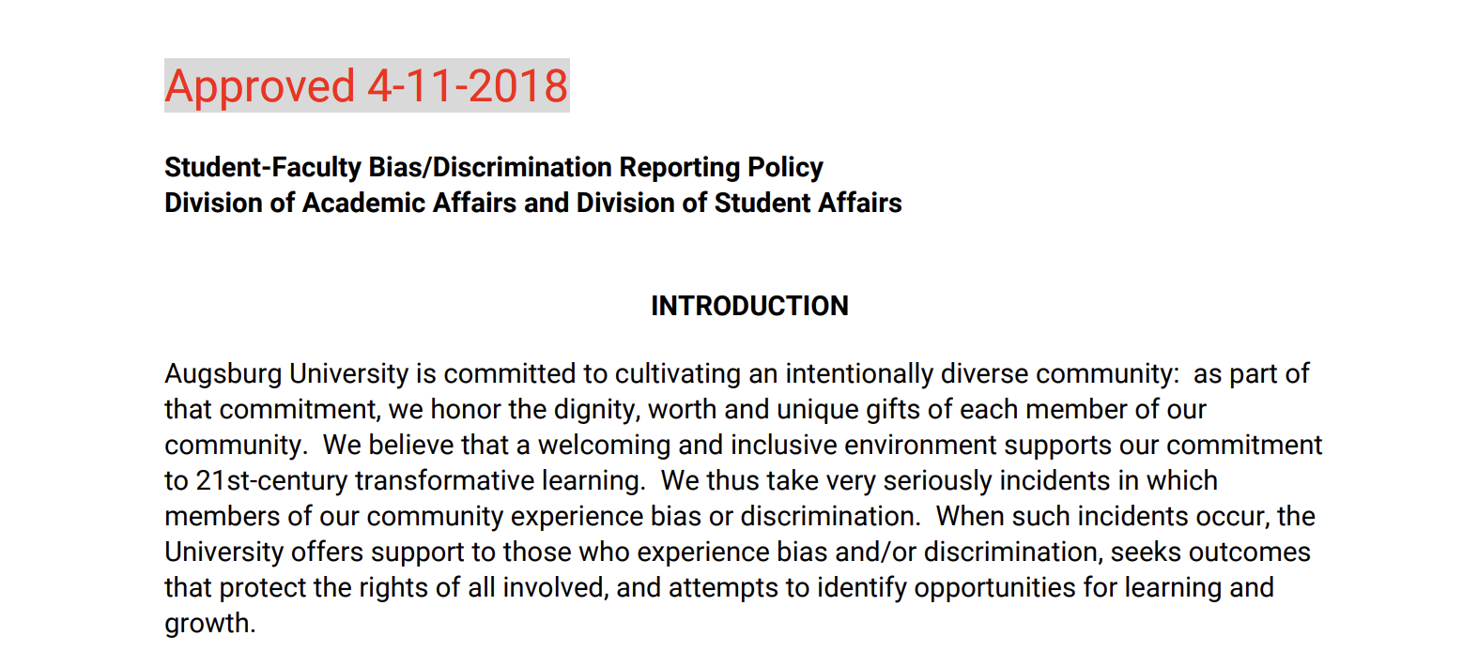
http://inside.augsburg.edu/academicaffairs/policies/

Slide 11
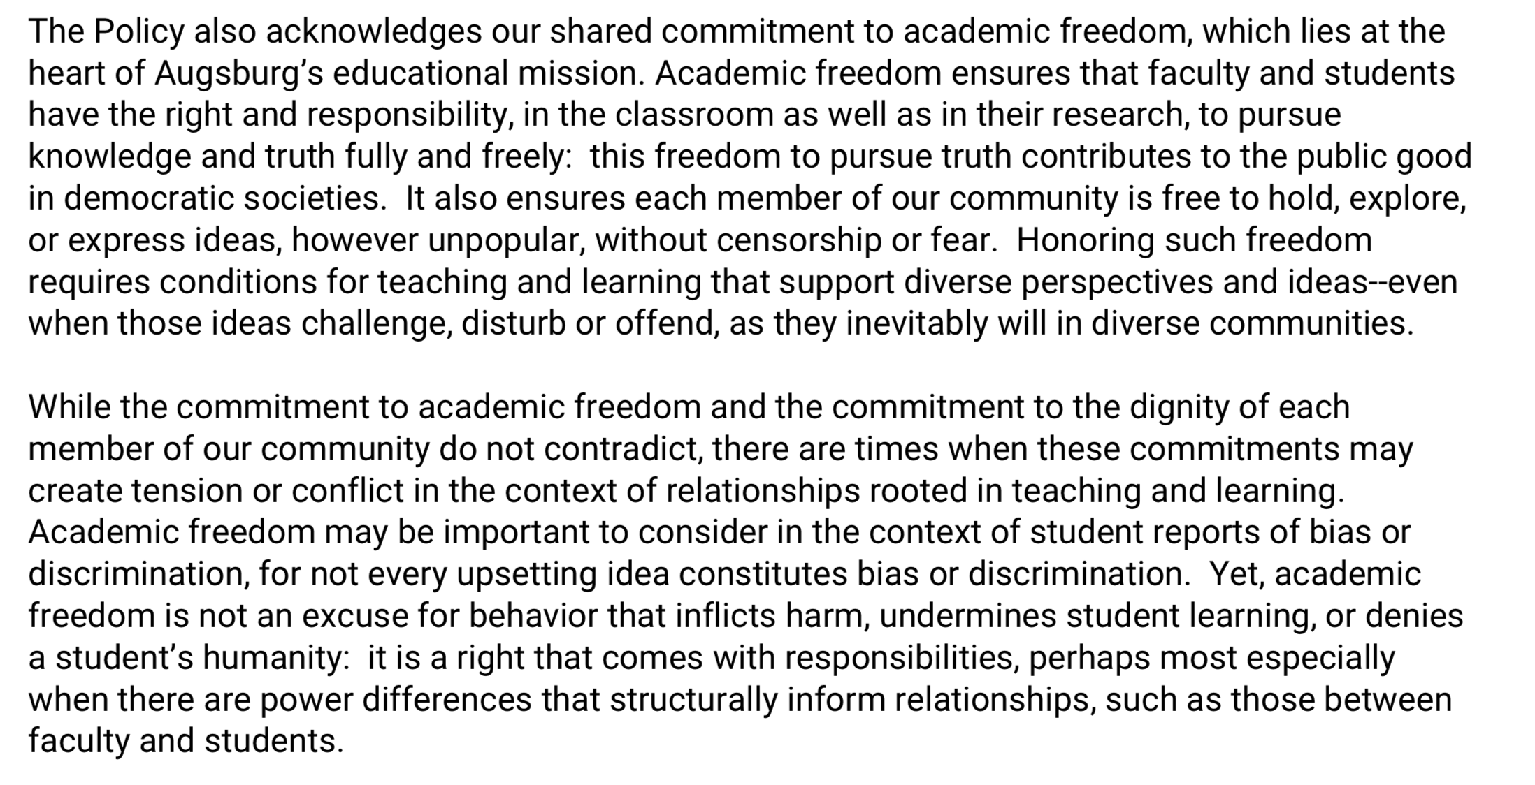

Slide 12

Augsburg Team: Karen Kaivola, Joaquin Munoz, Tim Pippert, Joanne Reeck

Slide 13


