Slide 1
Faculty Meeting
April 11, 2018

Slide 2
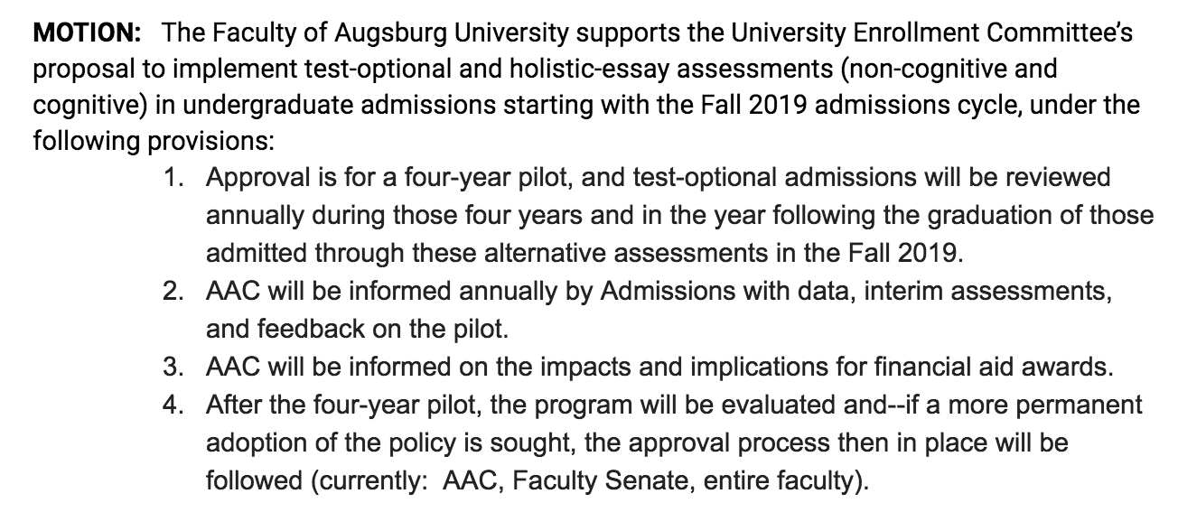
Test Optional Admissions

Slide 3
Bias/Discrimination Policy - revision
MOTION: The Faculty of Augsburg University supports the revised Bias/Discrimination reporting policy (April 2018 draft v3), a joint policy of Academic Affairs and Student Affairs, for reports by students that focus on experiences with faculty.

Slide 4
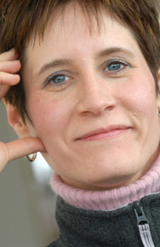
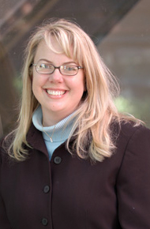
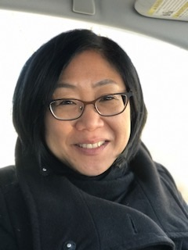
Faculty nominees - University Council
Christina Erickson Stacy Freiheit Bibiana Koh
‹#›

Slide 5
Committee Elections and Ratifications
ACADEMIC AFFAIRS COMMITTEE (AAC)
Continuing members:
Kristen Chamberlain, Comm. Studies (FA/H)
David Crowe, Biology (N/SS)
Phyllis Kapetanakis, Business (PS)
Kaycee Rogers, Education (At-large)
Mary Stortz, Religion (At-large)
Newly elected members:
Michael Kidd, Languages and Cross-Cultural Studies (FA/H)
Liaila Tajibaeva, Economics (N/SS)
Ana Ribeiro, Health, Physical Education, & Exercise Science (PS)
Suzanne Gikas, Education (At-large)

Slide 6
Committee Elections and Ratifications
ASSESSMENT COMMITTEE (AASC)
Continuing member:
Ben Denkinger, Psychology (N/SS)
Newly elected members:
Jenna McNallie, Communication Studies (H/FA)
Virginia McCarthy, Nursing (PS)

Slide 7
Committee Elections and Ratifications
FACULTY DEVELOPMENT COMMITTEE (FDC)
Continuing members:
Sarah Degner Riveros, Languages and Cross-Cultural Studies (At-large)
Won Yong Kim, Business Administration (PS)
Newly elected member:
Reinaldo Moya, Music (FA/H)
Please vote for one faculty member:
Rich Flint, MSCSC (FA/H)

Slide 8
Committee Elections and Ratifications
GRADUATE ACADEMIC AFFAIRS COMMITTEE (GAAC)
Continuing members:
Milda Hedblom, Political Science (At-large)
Jenny Kluznik, Physician Assistant Studies (PA)
Rachel Lloyd, Education (MAE)
Michael Schock, Social Work (MSW)
Deborah, Schuhmacher, Nursing (MAN/DNP)
Newly elected members:
George Dierberger, Business Administration (MBA)
Annie Heiderscheit, Music (MMT)
Lindsay Starck, English (MFA)
Alan Tuchtenhagen, Master of Leadership Studies (MAL)

Slide 9
Committee Elections and Ratifications
STUDENT STANDING COMMITTEE (SSC)
Continuing members:
Nishesh Chalise, Social Work (At-large)
Terrance Kwame-Ross, Education (PS)
Newly elected member:
Maheen Zaman, History (FA/H)

Slide 10
Committee Elections and Ratifications
COMMITTEE ON TENURE AND PROMOTION (CTP)
Continuing members:
Mark Tranvik, Religion (FA/H)
Ben Stottrup, Physics (N/SS)
Joe Erickson, Education (PS)
Diane Pike, Sociology (At-large)
Newly elected member:
Andy Aoki, Political Science (N/SS)
Please vote for one faculty member:
Anthony Clapp, Health, Physical Education & Exercise Science (PS)

Slide 11
Committee Elections and Ratifications
ADMISSIONS AND ENROLLMENT COMMITTEE (AASC)
Continuing members:
Evren Guler, Psychology (N/SS)
Jayoung Koo, Business (PS)
Newly elected member:
Matthew Maruggi, Religion (FA/H)

Slide 12
Committee Elections and Ratifications
UNIVERSITY COMMITTEE ON ACADEMIC PLANNING (UCAP)
Continuing member:
Laura Boisen, Social Work (PS)
Newly elected members:
Jacqui deVries, History (FA/H)
Matthew Beckman, Biology (N/SS)
Senate member chosen by Senate in Fall. One year term.

Slide 13
Committee Elections and Ratifications
FACULTY EQUITY COMMITTEE
Newly appointed members:
Jeanne Boeh, Economics
Sarah Combellick-Bidney, Political Science
Three Senators chosen by Senate in Fall for a one year term.

Slide 14
Committee Elections and Ratifications
FACULTY COMPENSATION COMMITTEE
Continuing members:
Matt Beckman, Biology (N/SS)
Jason Lukasik, Education (PS)
Newly appointed members:
Robert Cowgill, English (FA/H)
Jeanne Boeh, Economics (At-large)
Jody Sorensen, Mathematics, Statistics & Computer Science (At-Large)

Slide 15
Committee Elections and Ratifications
PERSONNEL POLICIES COMMITTEE (PPC)
Continuing members:
Matthew Haines, Mathematics, Statistics & Computer Science (N/SS)
Ankita Deka, Social Work (PS)
Newly appointed members:
Merilee Klemp, Music (FA/H)
Bob Groven, Communication Studies (At-large)

Slide 16
Committee Elections and Ratifications
PARLIAMENTARIAN
Newly appointed member:
Robert Groven, Communication Studies

