Slide 1
Liberal Learning for the 21st c.
Focused conversation #2 in the Gen Ed Review:
How do our students navigate the curriculum?
The Team: Matthew Beckman (Biology), Pavel Belik (Math), Katie Bishop (Dean’s Office), Ben Denkinger (Psychology), Jacqui deVries (Gen Ed / History), Chris Houltberg (Art), Doug Green (English), Elise Marubbio (American Indian Studies), Shannon Smith (advising), Stu Stoller (Business) -- with support from Mara Kilgore, carrie shidla, William mullen, and many others

Slide 2
Guiding Philosophy: General Education …
“is more than simply a curriculum; it is possibly the most important manifestation of an institutions educational mission.”*
should include a clear programmatic purpose, resonate with the institution’s distinctive mission, and include transparent, powerful goals and outcomes for student learning
needs to provide guided pathways to create equitable access to excellence for all students**
should prepare a student for Signature Work***
*Andrea Leskes and Ross Miller, General Education: A Self-Study Guide for Review and Assessment (AACU, 2005), p.3.
**Paul L. Gaston, General Education Transformed: How We Can, Why We Must (AACU 2015).
***Carol Geary Schneider, “The Leap Challenge,” Liberal Education (Winter/Spring 2015)

Slide 3
Why consider revisions now?
Don’t we have enough change going on at the College?
Changing Institutional Contexts:
In 2009, the College adopted a new mission statement
In 2014, the faculty approved new institutional Student Learning Outcomes (iSLOs)
The student body has grown increasingly diverse
Institutional assessment data is revealing shortcomings in student achievement in key areas.
Changing External Contexts:
Since 2002, the political and economic landscape of the country has shifted
Since the Great Recession, students and parents place more emphasis on ROI, requiring colleges to rearticulate the benefits of liberal learning
High school curriculum has changed during this time (“No Child Left Behind”)
Technology has pervaded the educational experience

Slide 4
Student Learning Outcomes –
Adopted by faculty in December 2014
As INFORMED CITIZENS, students are learning to …
engage their communities and demonstrate a sense of agency to create change in ethical and informed ways
(Civic Engagement/Ethical Reasoning)
explain diverse positions and collaborate effectively across social, cultural and geographic differences in local and global contexts (Global Awareness/Intercultural Competence)
As THOUGHTFUL STEWARDS, students are learning to …
critically engage their own beliefs and articulate their gifts and goals for meaningful life and work in a pluralistic context
(Vocation/Religious Literacy)
identify the broad foundations for sustainable living and apply them in demonstrable ways (Health and Wellness/Sustainability)

Slide 5
Student Learning Outcomes –
Adopted by faculty in December 2014
As CRITICAL THINKERS, students are learning to …
use appropriate methods to gather and analyze evidence, identify underlying assumptions, and evaluate competing claims
(Critical Thinking / Information Literacy)
construct coherent, polished and persuasive arguments, narratives and explications in written, oral and other formats
(Writing / Oral Communication)
As RESPONSIBLE LEADERS, students are learning to …
employ the fundamental principles of quantitative literacy to arrive at thoughtful judgments (Quantitative Literacy)
articulate and solve problems in creative, analytical, and integrative ways (Problem Solving / Integrative Learning)

Slide 6
Some preliminary conclusions
Our curriculum lacks “guided pathways” and can seem like a checklist of unconnected courses
Our iSLOs are not integrated consistently into the curriculum
Certain key skills need greater clarity and emphasis (e.g. Critical Reading, Writing-across-the-Curriculum, Quantitative Reasoning, Information Literacy)
Some areas of our curriculum need greater clarity (e.g. Modern Language: is the goal language fluency or intercultural competency?)
Gen Ed needs built-in flexibility to ensure AU & transfer students meet iSLOs
We need to redouble our efforts to have long-term faculty teach our core classes

Slide 7
A Proposed Timeline for Revisions:
2019
2015-16 Review
2016-17
Design
2017-18 Implement

Slide 8
Supporting Data for Focused conversation #2:
How do our students navigate the core curriculum?
One perspective:
“The masses of college students are left with a thin veneer of course distribution to cover their essentially vocational education.” -- Michael W. Clune, Chronicle of Higher Education (Dec. 6, 2015)

Slide 9
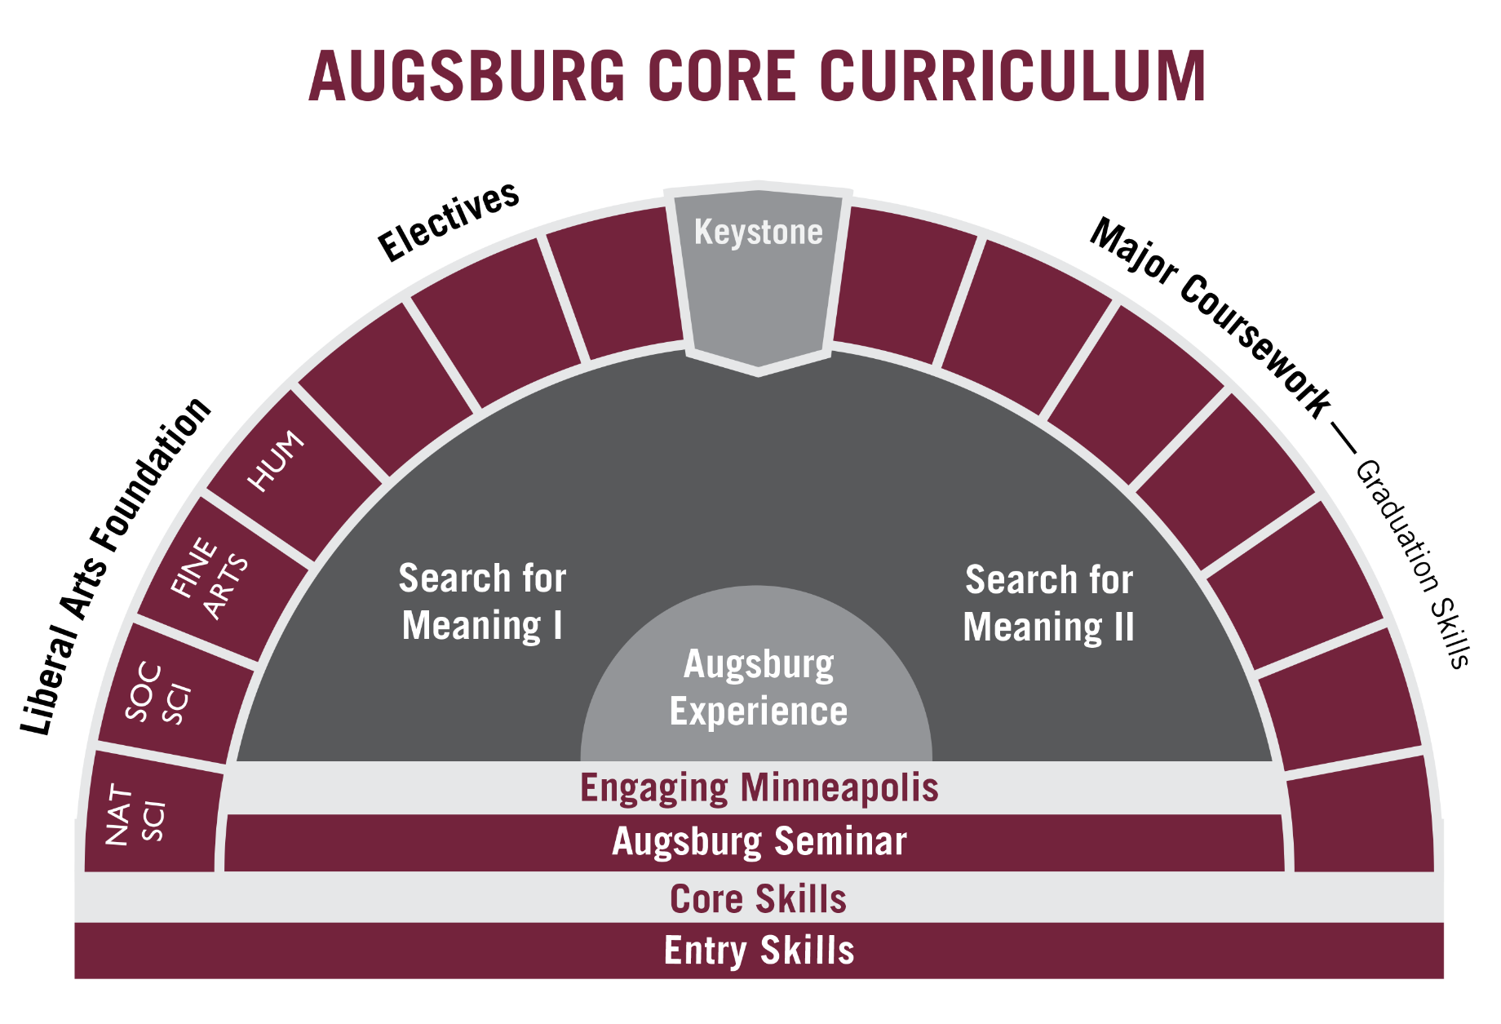
Distribution (LAFs) + Signature Curriculum (REL / KEY) + Skills + Experiences (EM / AUGEX)

Slide 10
Liberal Arts Foundation courses:
% of students fulfilling all requirements at Augsburg
“Fifteen years ago, AP, IB, and PSEO transfer credit was the exception; now it’s the norm” –
William Mullen, VP Enrollment Management

Slide 11
Transfer Students*
*The MN transfer agreement (the “Auggie Plan”), signed with area community colleges in June 2015, is expected to boost transfer #s:

Slide 12
Transfer Students: now make up 35% or more of our undergraduate student population

Slide 13
Effective Writing:
More than 40% of students do not take ENL 111 at Augsburg

Slide 14
Effective Reading?
Nearly 40% of first-year students fall in the bottom two quintiles of ACT Reading scores

Slide 15
Modern Language Requirement
Most Common Languages:
Hmong
Amharic
Somali
Arabic
Vietnamese
Lao
Swahili

Slide 16
Modern Language requirement:
% of graduates completing courses at Augsburg

Slide 17
Too many requirements?
A Sample Comparison of Required Credits for Major / Core*
*assuming a mythical student who places into MPG 4/Effective Writing /Modern Language I and has no credits in transfer. This does not include HPE or Augsburg Experience as a credit, since these can be done through non-credit experience.

Slide 18
Instructor Status (Spring 2016):
% of Gen Ed courses taught by adjuncts (estimate)
*NSM / lab courses do not include #s for labs taught by additional professors

Slide 19
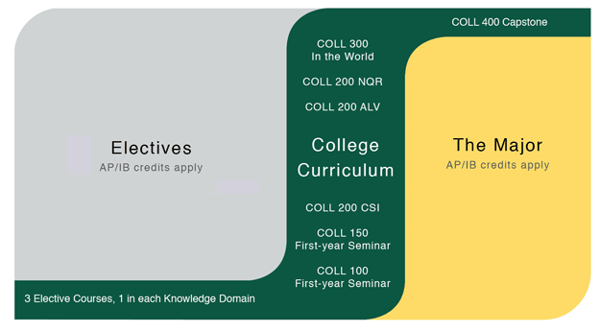
Other Models of General Education
COLL 100 is about big questions and big ideas — the significant concepts, beliefs and creative visions, theories and discoveries that have shaped our understanding of the world.
COLL 150 asks students to engage in deep readings and group discussions of texts, data, or methods of inquiry from the discipline.
COLL 200 courses are about the academic disciplines – about where their practices intersect and diverge, the various ways they approach questions of evidence and conclusions, and how, together, they comprise the broader framework of the liberal arts.
William and Mary’s new “College Curriculum” approved by faculty in 2013 and scheduled for adoption on 2015: focuses on skills, methods, connections and integration

