Slide 1
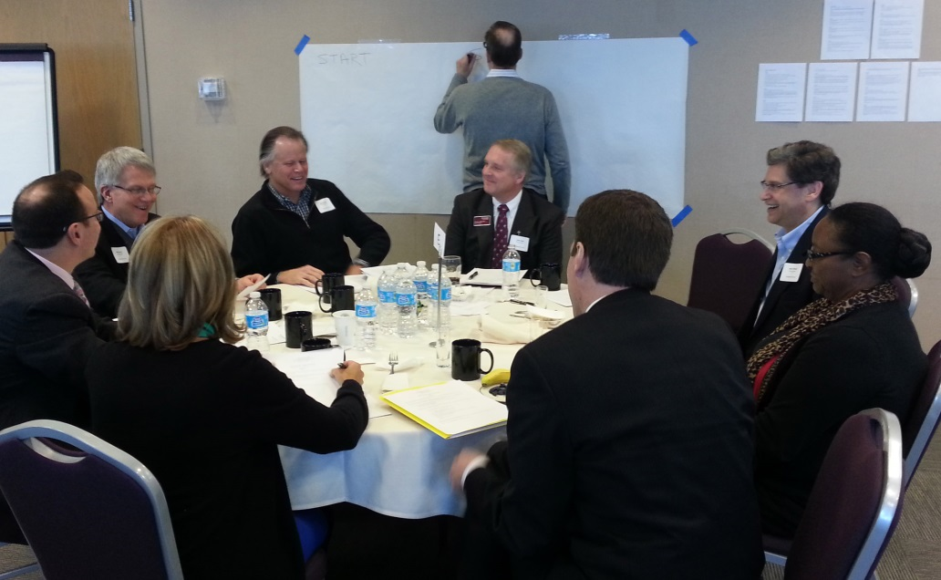
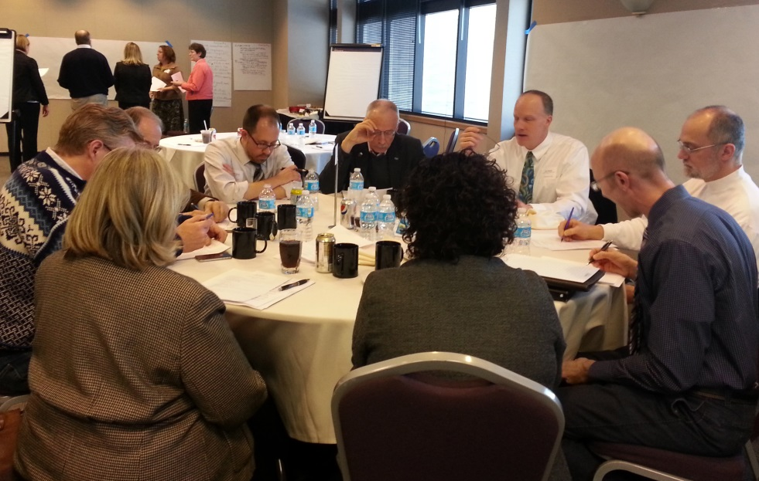
Augsburg 2019
July 26, 2013

Slide 2
Augsburg 2019: A new kind of university…
a student-centered, urban university that is small to our students and big for the world.
OUR ACADEMIC DISTINCTION: Augsburg students are active and engaged, intentionally preparing for lives of meaningful work and service. Programs are experiential, interdisciplinary, global and aimed at success for every student.
OUR REPUTATION & MARKET POSITION: Augsburg is at the table—innovating and refining our programs to meet contemporary workforce needs and social challenges. Augsburg graduates are equipped to follow their vocational journeys and to compete in the selective job market of 2019.
OUR INSTITUTION: We are deliberately organized as a new kind of 21st century university. Augsburg is designed to be nimble, to focus on outcomes and to keep its promises.

Slide 3
Augsburg 2019 – Elevator Version
In 2019, Augsburg is a new kind of student-centered, urban university that is small for our students but big for the world
Education for service across the disciplines, beyond the classroom, and around the world
Augsburg is at the table with our community, shaping education that serves the world
Keeping our promises; Augsburg is accountable and organized around outcomes

Slide 4
Augsburg 2019 Dilemmas
mantra vs. matrix
cultural change vs. structural change
unprecedented university model - how do we inspire the imagination required to invent it?

Slide 6
Centers as part of our strategic framework
The 2007-9 initiative to create four centers of commitment was a challenge:
to give form to these signature commitments
to align and strengthen campus efforts as cross-cutting
to represent and connect outside Augsburg
For Augsburg to be at the table in 2019, we need these centers.
Leadership outside Augsburg: to be in the vanguard of experiential, global, vocation-focused education
Leadership inside Augsburg: strengthening effective practice in Augsburg programs

Slide 7
Augsburg 2019: A new kind of university…
a student-centered, urban university that is small to our students and big for the world.
OUR ACADEMIC DISTINCTION: Augsburg students are active and engaged, intentionally preparing for lives of meaningful work and service. Programs are experiential, interdisciplinary, global and aimed at success for every student.
OUR REPUTATION & MARKET POSITION: Augsburg is at the table—innovating and refining our programs to meet contemporary workforce needs and social challenges. Augsburg graduates are equipped to follow their vocational journeys and to compete in the selective job market of 2019.
OUR INSTITUTION: We are deliberately organized as a new kind of 21st century university. Augsburg is designed to be nimble, to focus on outcomes and to keep its promises.

